Slide 1
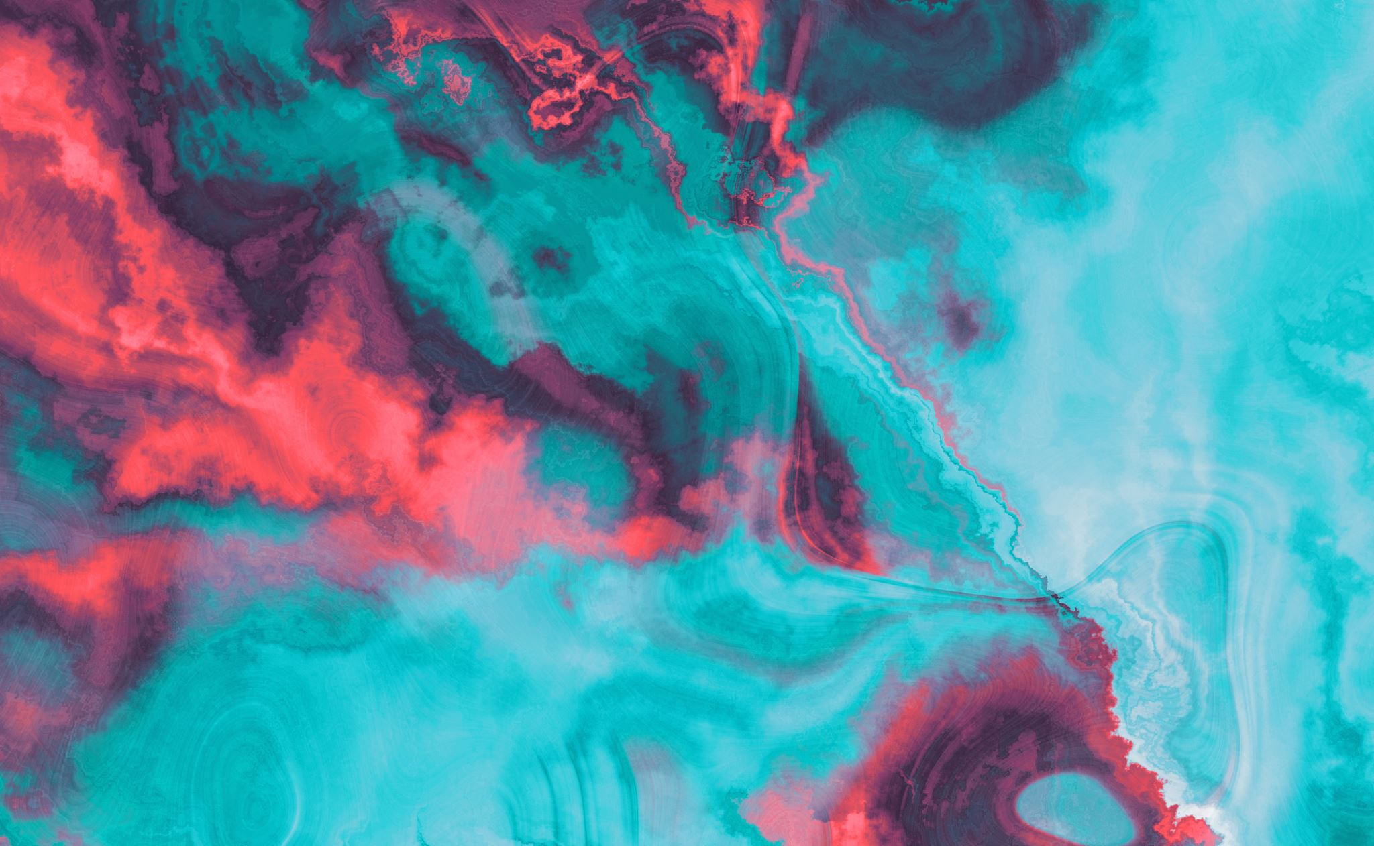
Style transfer
Notes:
You all know that if I show a Convolutional Neural Network (CNN) a picture of a dog, it will classify it as a 'dog.'
But here is the interesting part: It works even if the picture is black and white. It works if the lighting is weird. It even works if I apply an Instagram filter to it.
Think about what that means.
If the model can still see the 'dog' despite the 'filter,' it means that somewhere inside its mathematical brain, it has the ability to separate the Content (the dog) from the Style (the colors and textures).
Today, we are going to hack into that brain, find exactly where that separation happens, and use it to paint like Van Gogh.

Slide 2
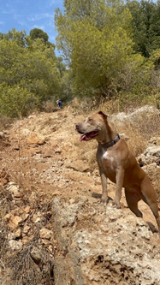
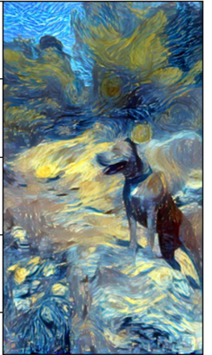
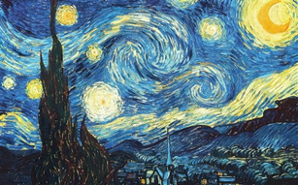
The idea
Target picture
Content picture
Style picture
Recognize style:
Using early convolutional layers.
Extracting colors and textures.
Balancing content and style:
Using weights for each style layer.
Early layers – colors, edges & simple textures
Late layers – shapes, objects & complex textures
Using loss function between relevant convolutional layers of the target, content and style pictures
Recognize content:
Using late convolutional layer.
Extracting the main content in the picture (that we want to preserve).

Slide 3
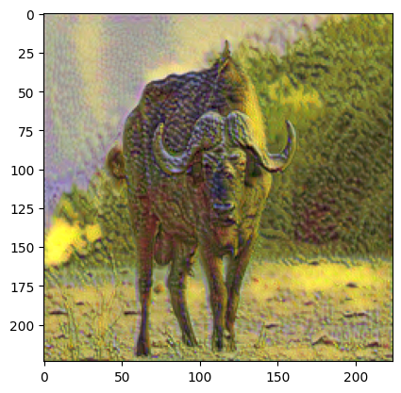
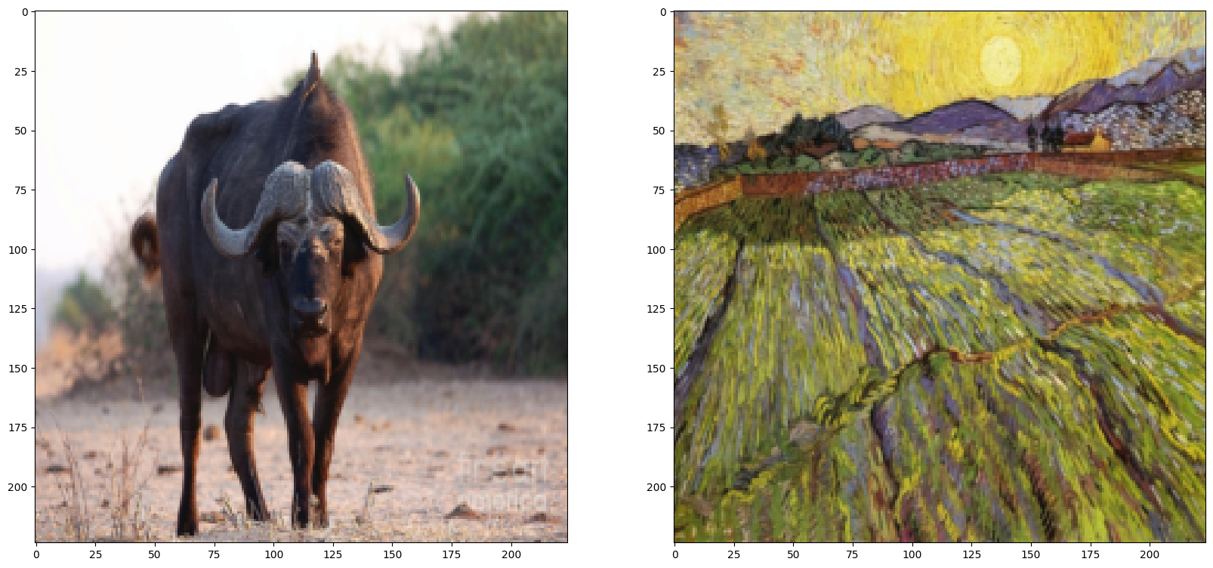
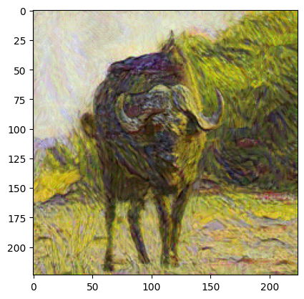
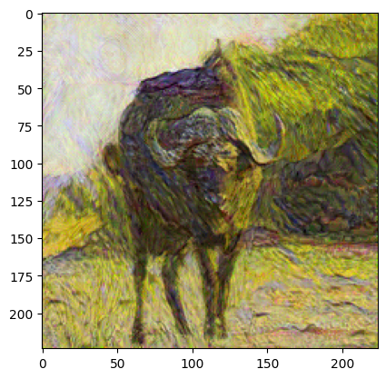
Convolutional layers
Only the first conv layer as style.
Adding the next 2 conv layers.
Using VGG19 conv layers.
Adding the rest conv layers.

Slide 4
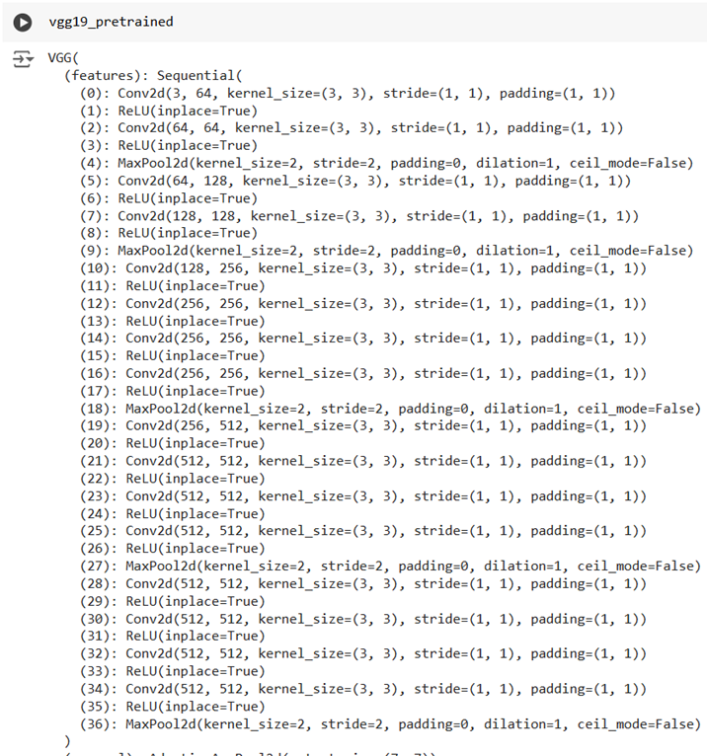
Convolutional layers
CONV1: Low-level features (colors & edges) (0)
CONV2: Simple textures (local patterns) (5)
CONV3: Mid-level patterns (motifs & textures) (10)
CONV4: High-level style (complex structures & textures) (19)
CONV5: Content (high-level structure) (21)
CONV6: Very high-level features (semantic) (28)

Slide 5
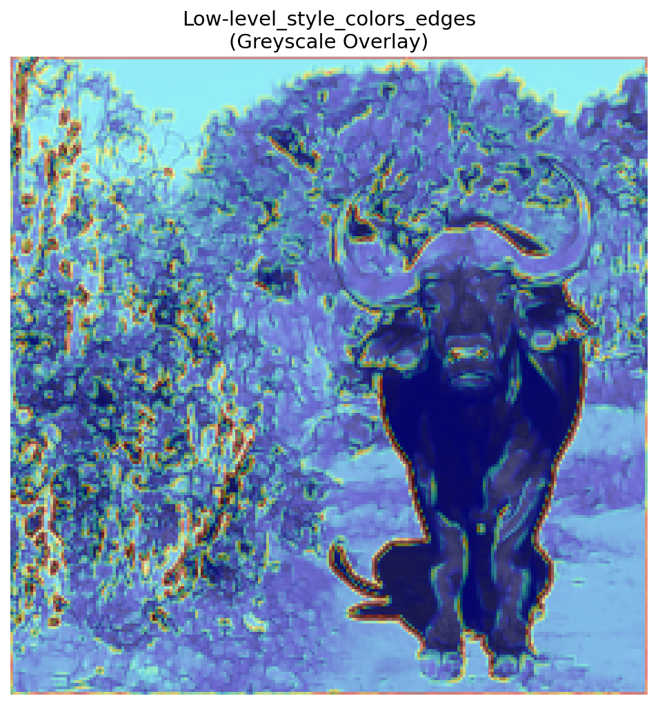
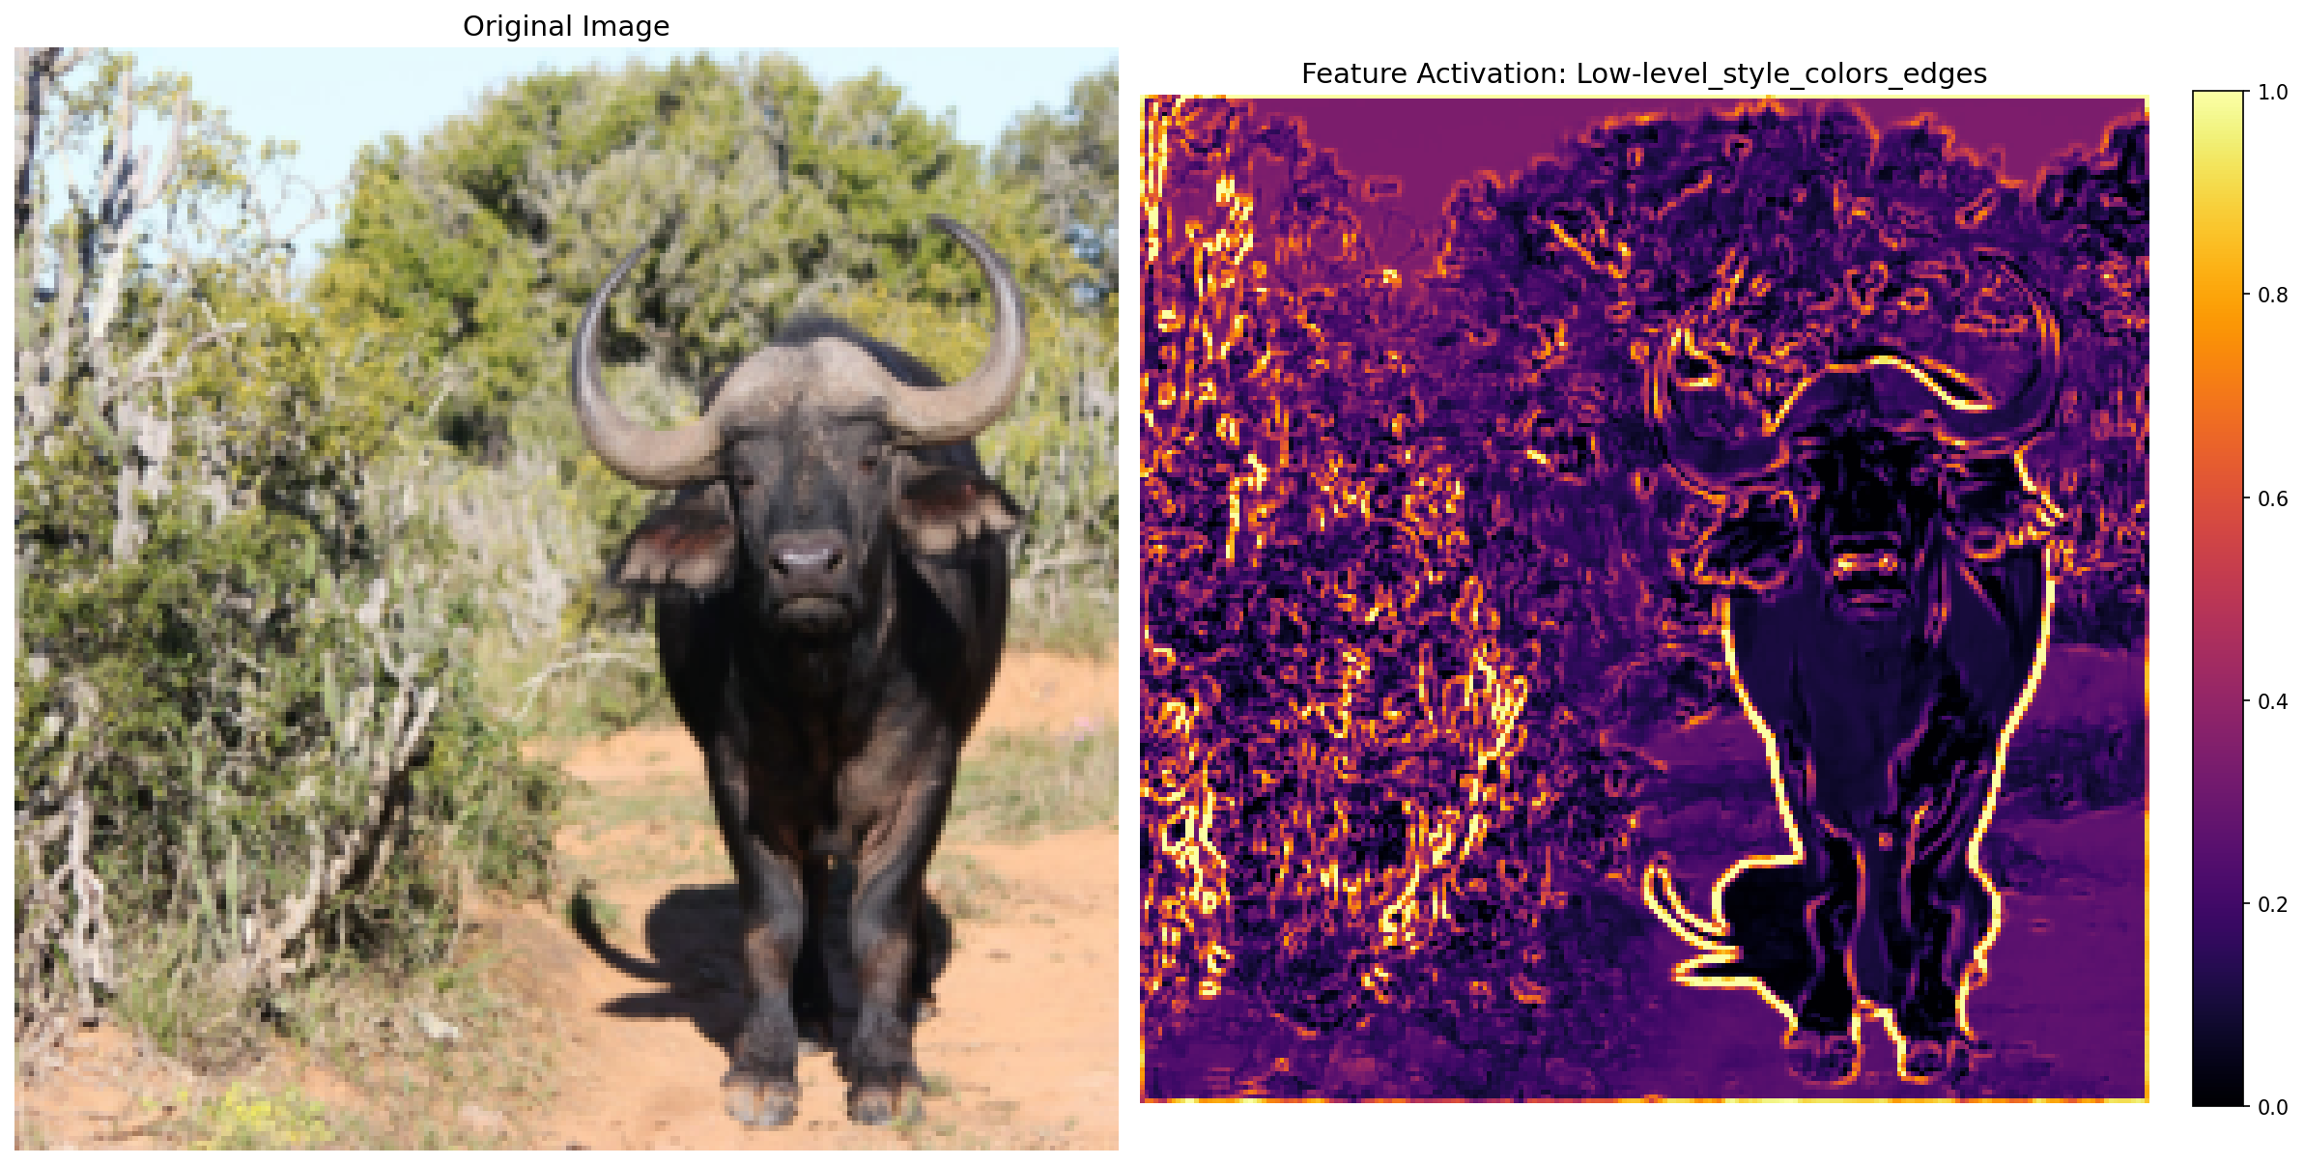
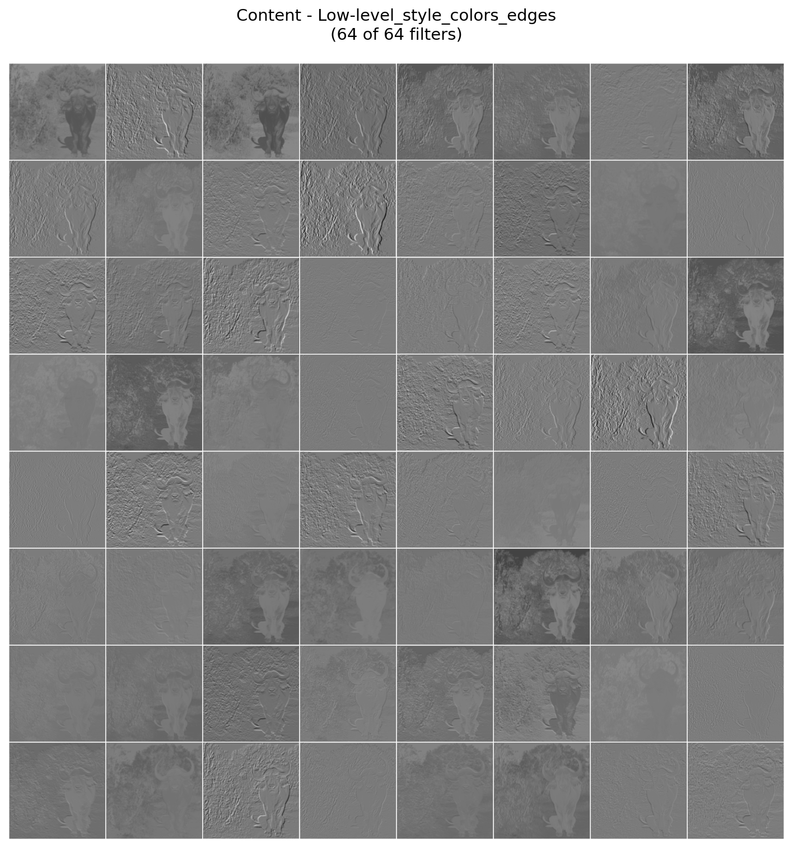
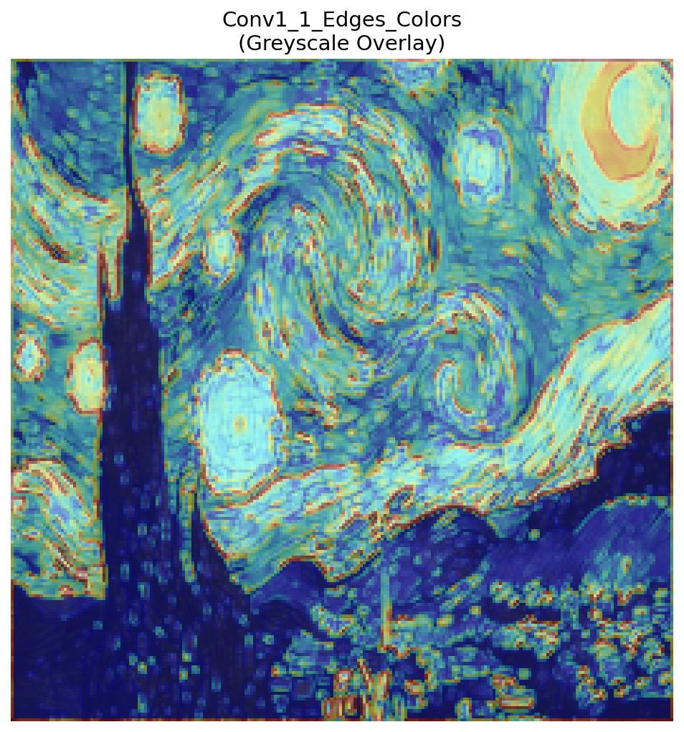
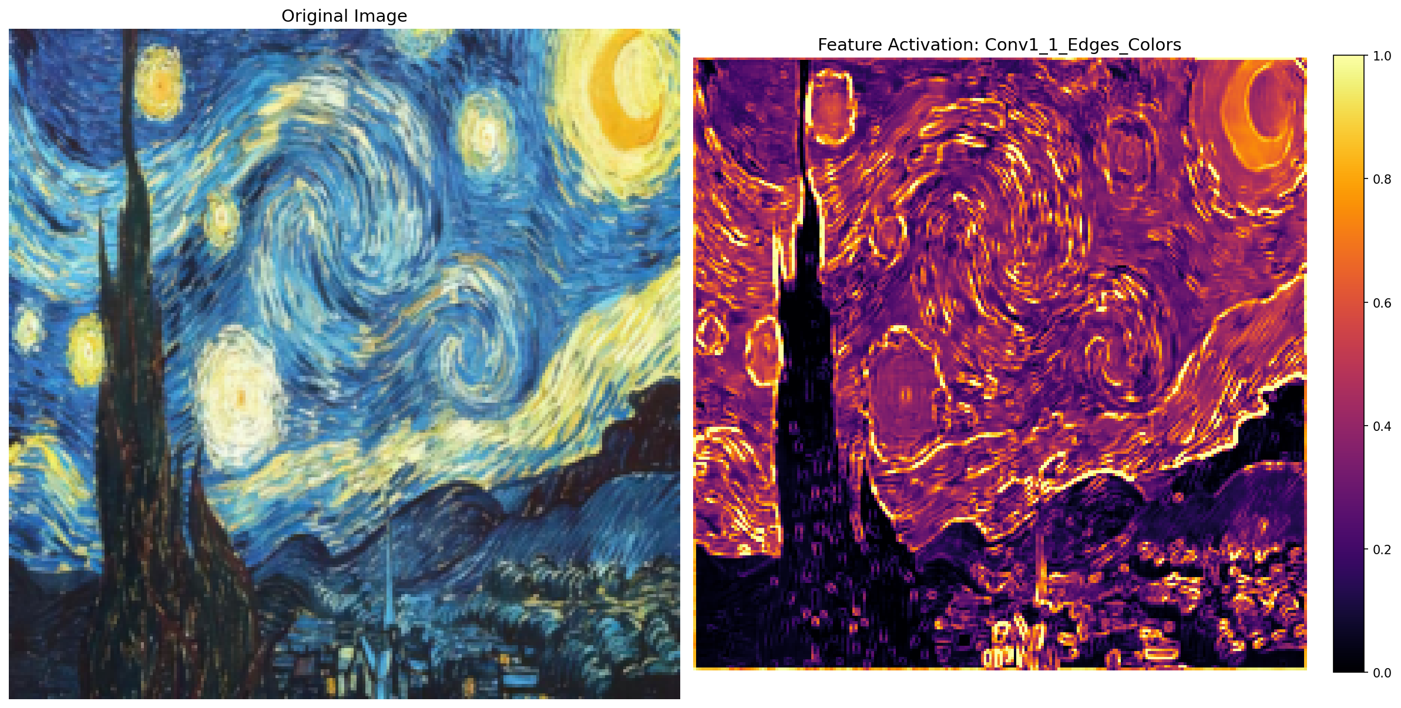
Convolutional layers
Conv 1
.
.
.
Notes:
See how the heatmap glows everywhere? This layer is obsessed with edges and colors. It doesn't know there is a buffalo; it just sees 'vertical line' or 'brown pixel'. This is perfect for capturing Style (brush strokes), but bad for content.

Slide 6
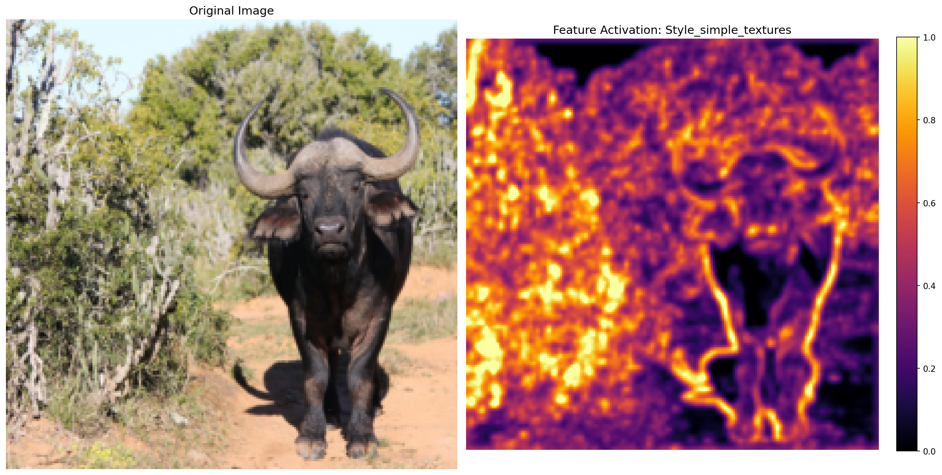
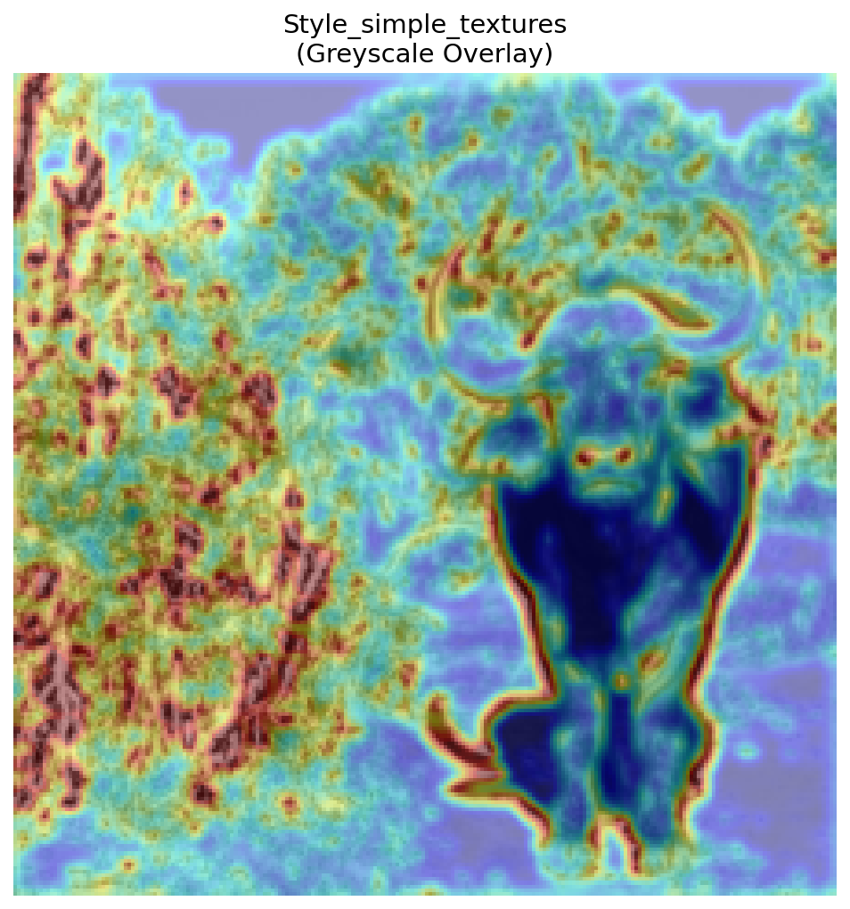
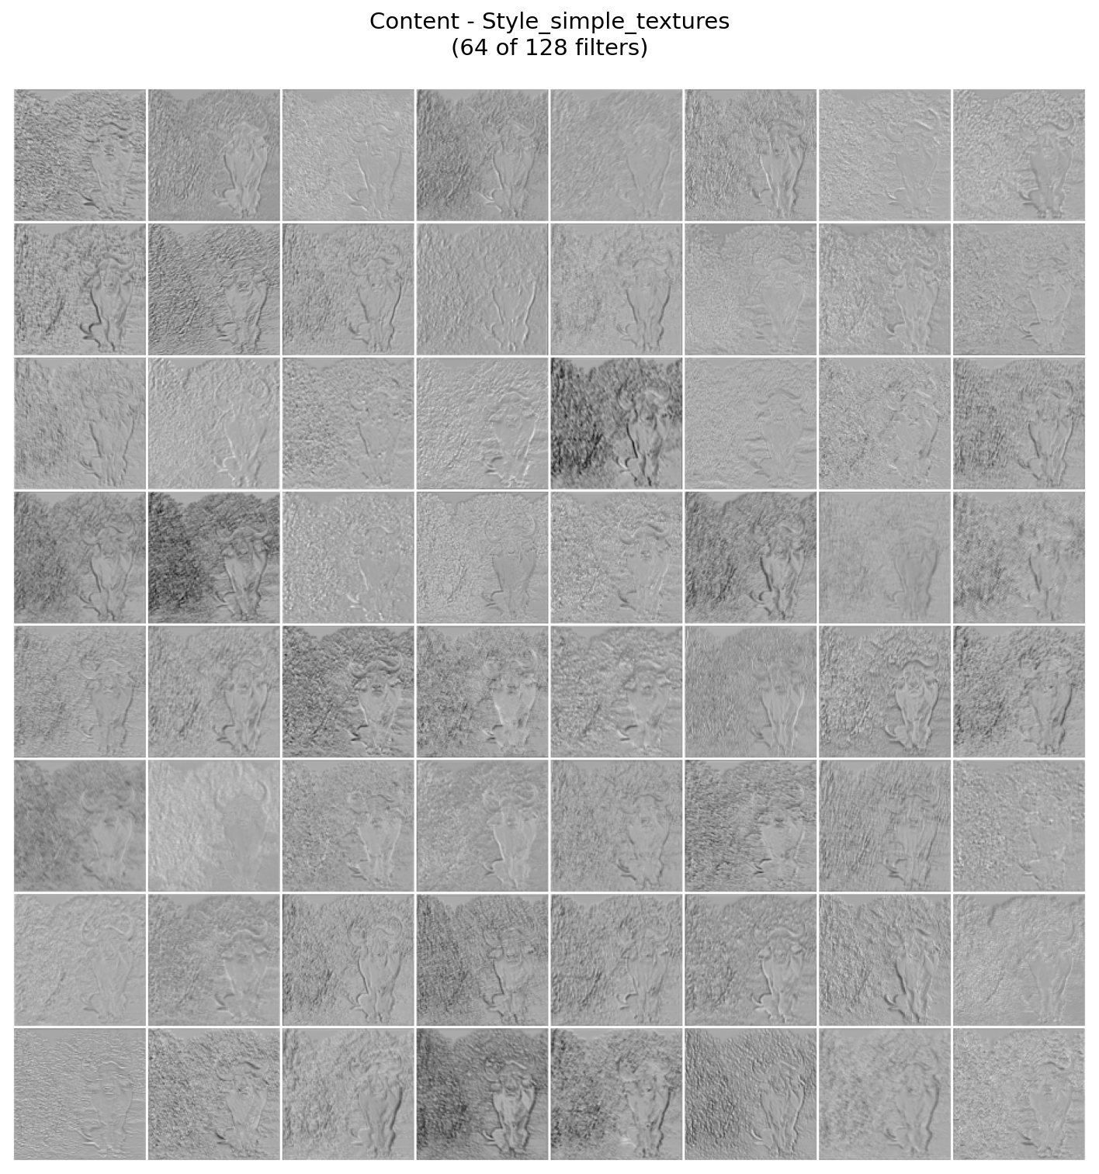
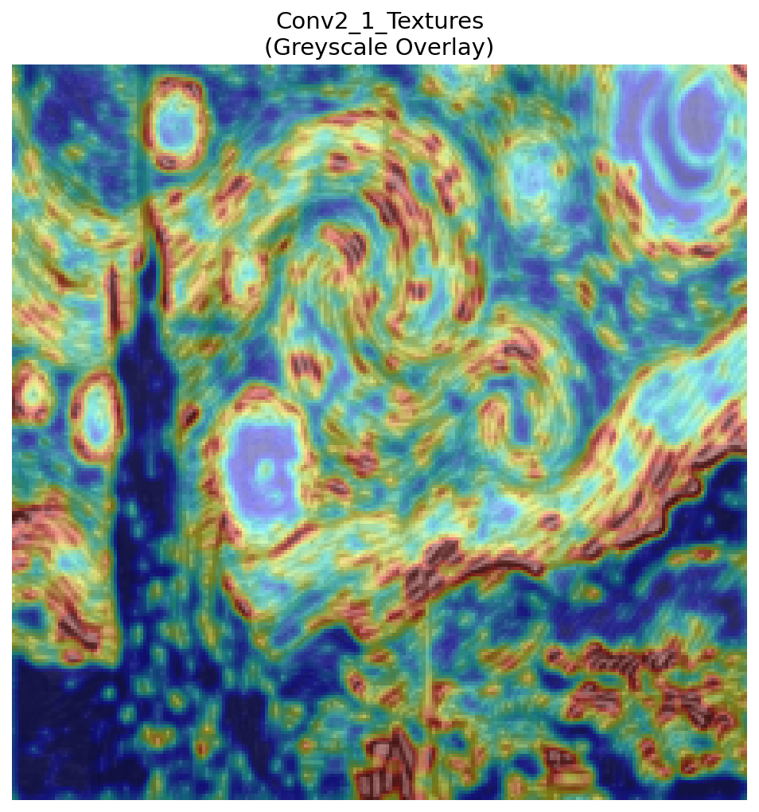
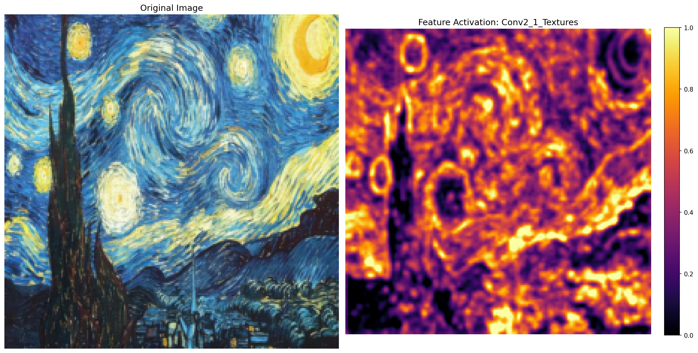
Convolutional layers
Conv 2
.
.
.
Notes:
As we go deeper to Conv2 and Conv3, the network stops looking at pixels and starts seeing textures. It recognizes 'fuzzy' or 'swirly'. This is the heart of the Style. It captures the pattern of the painting.

Slide 7
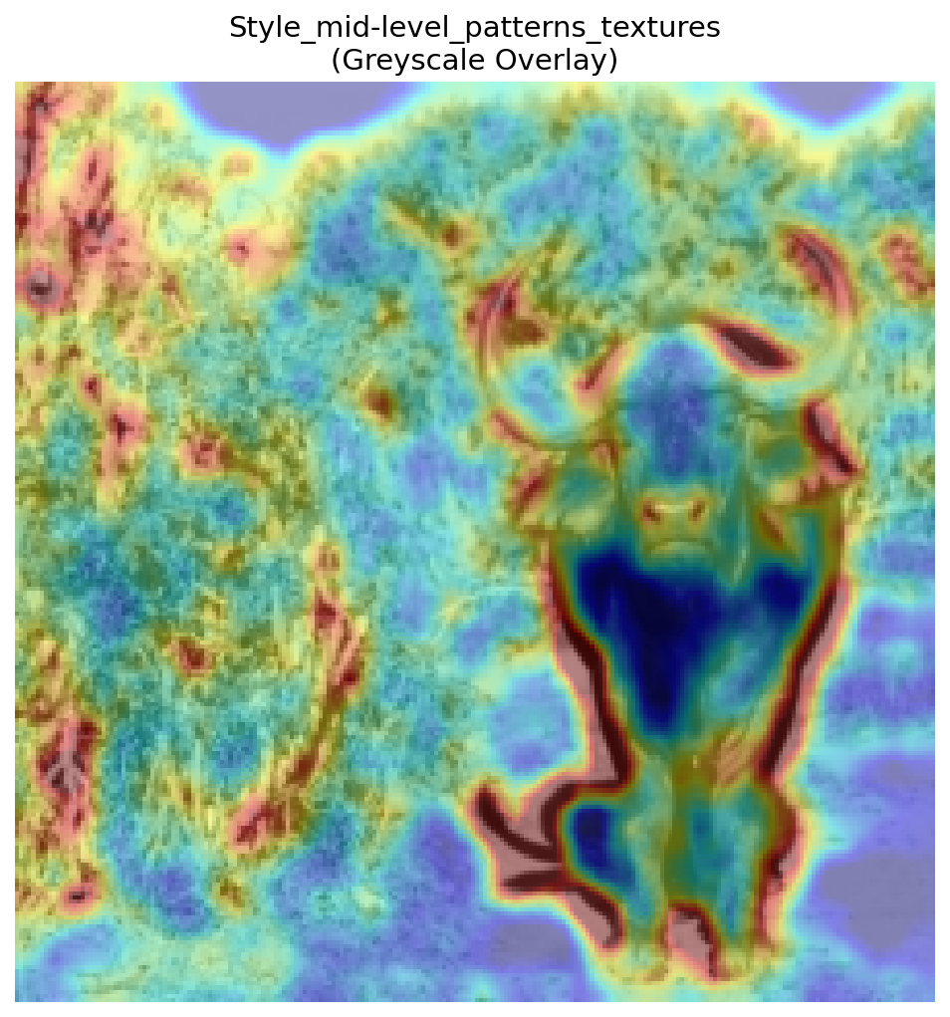
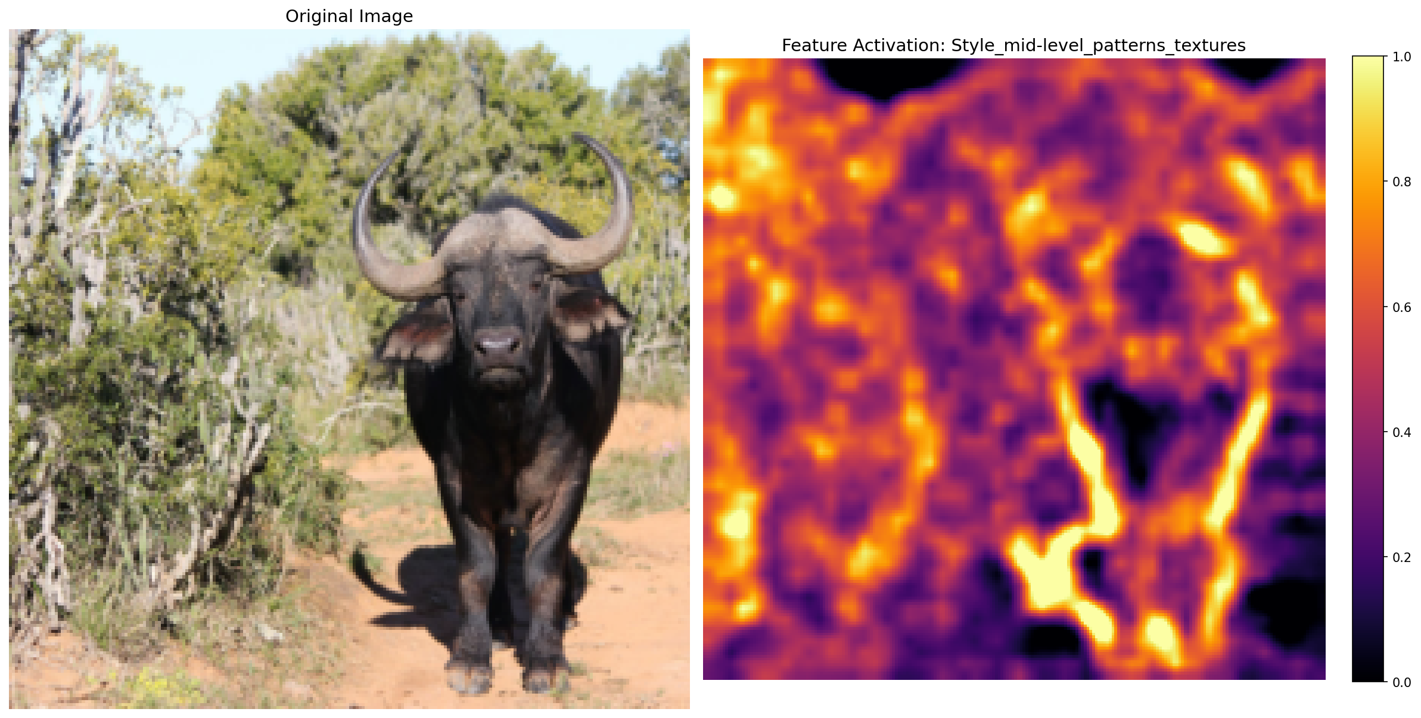
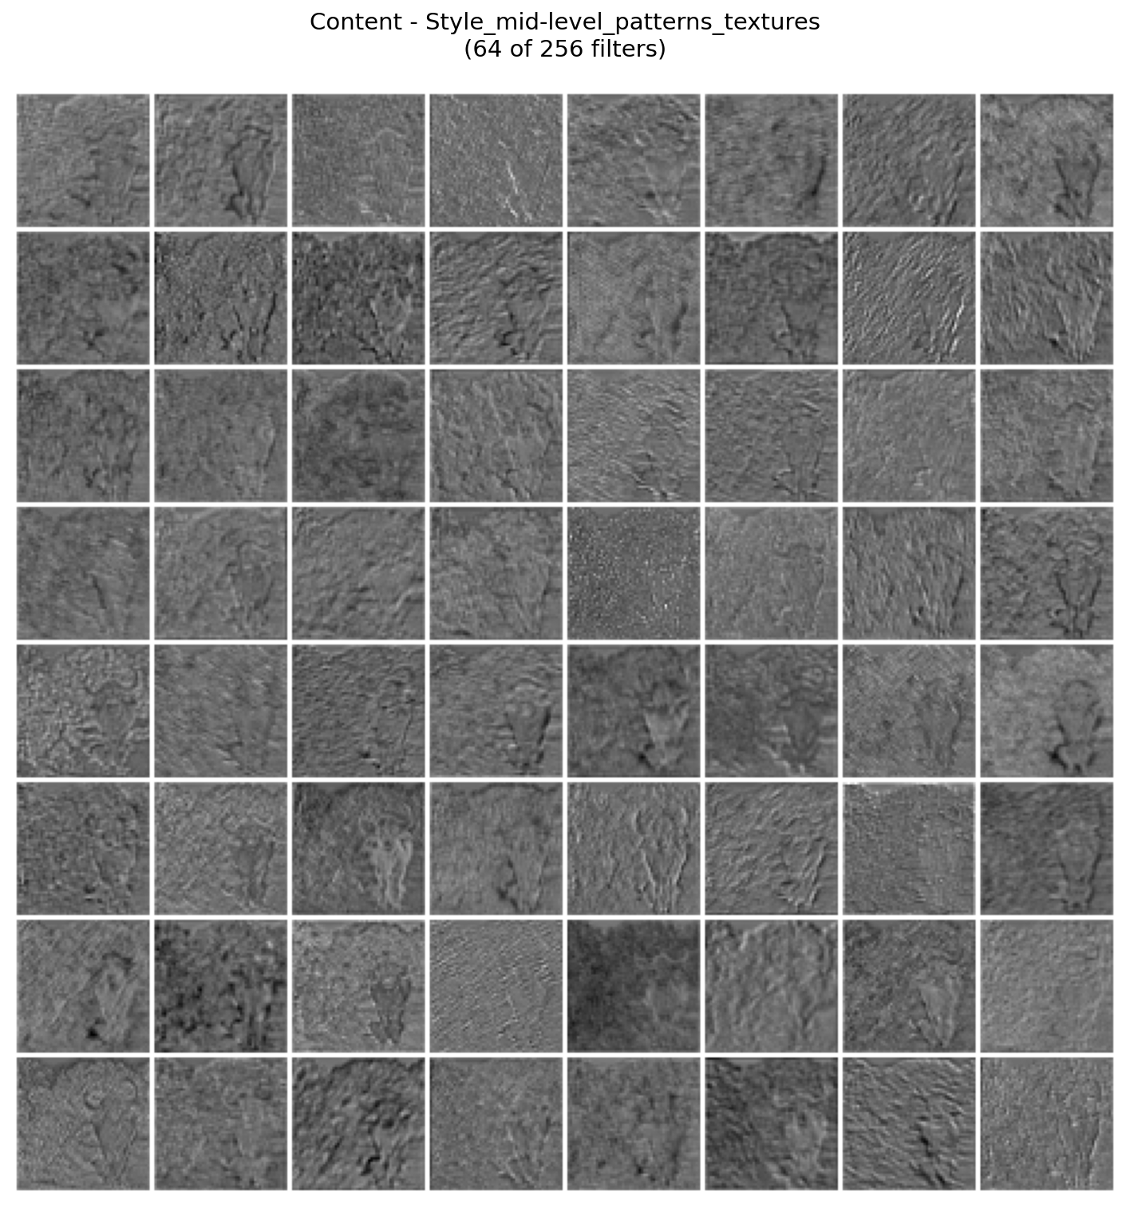
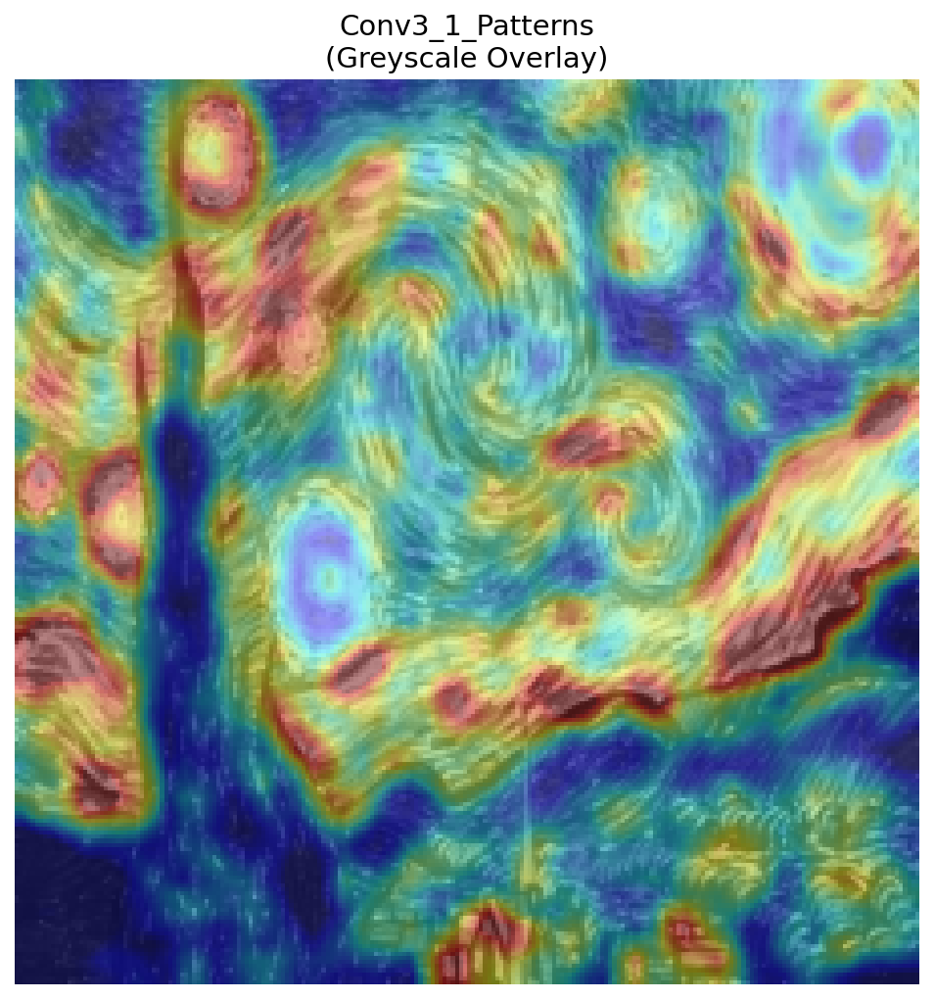
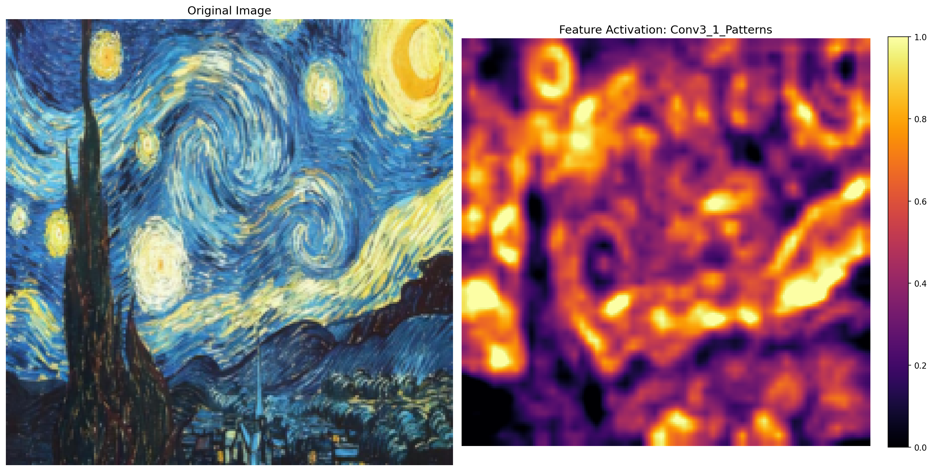
Convolutional layers
Conv 3
.
.
.
Notes:
As we go deeper to Conv2 and Conv3, the network stops looking at pixels and starts seeing textures. It recognizes 'fuzzy' or 'swirly'. This is the heart of the Style. It captures the pattern of the painting.

Slide 8
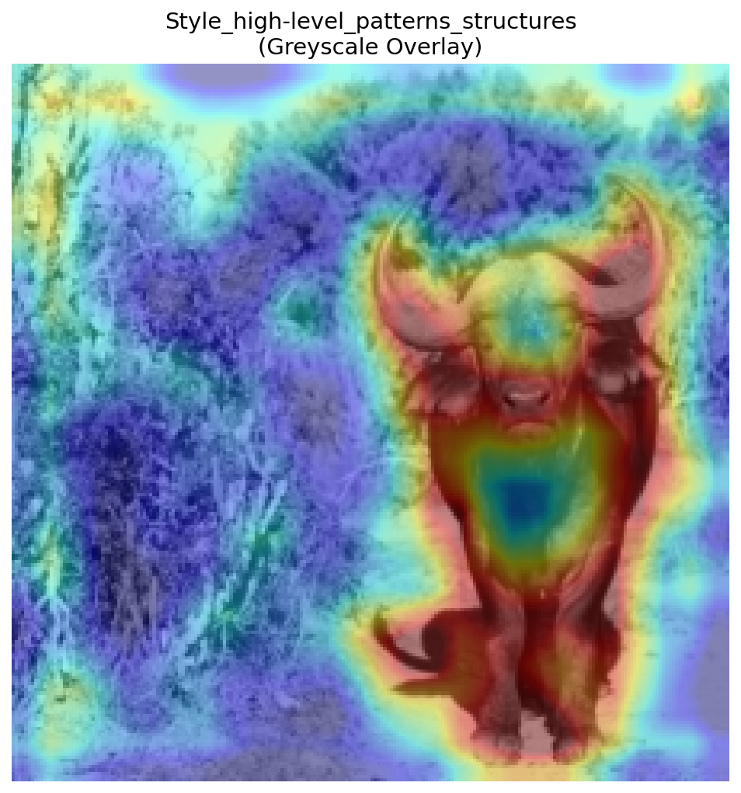
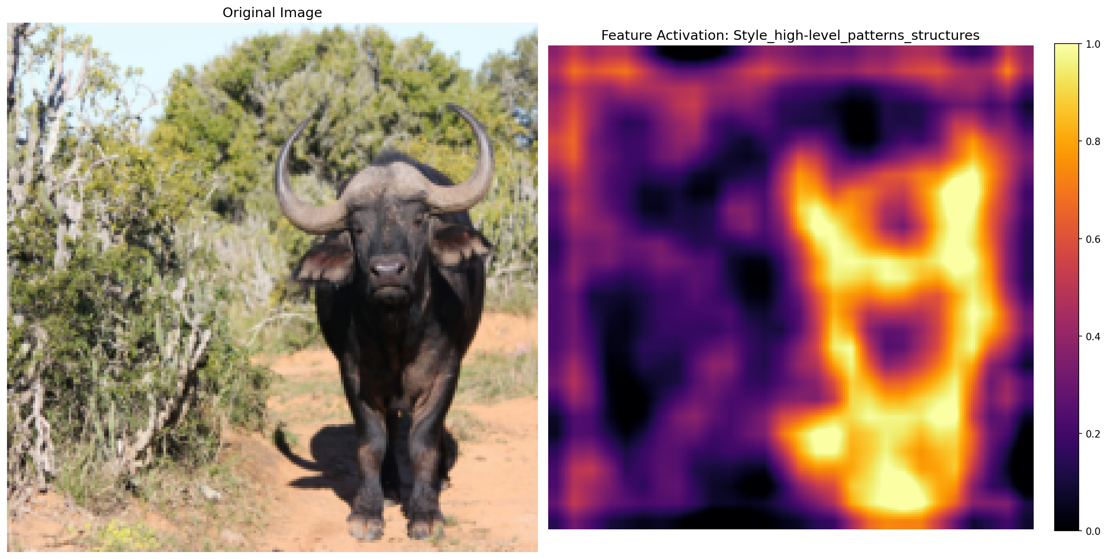
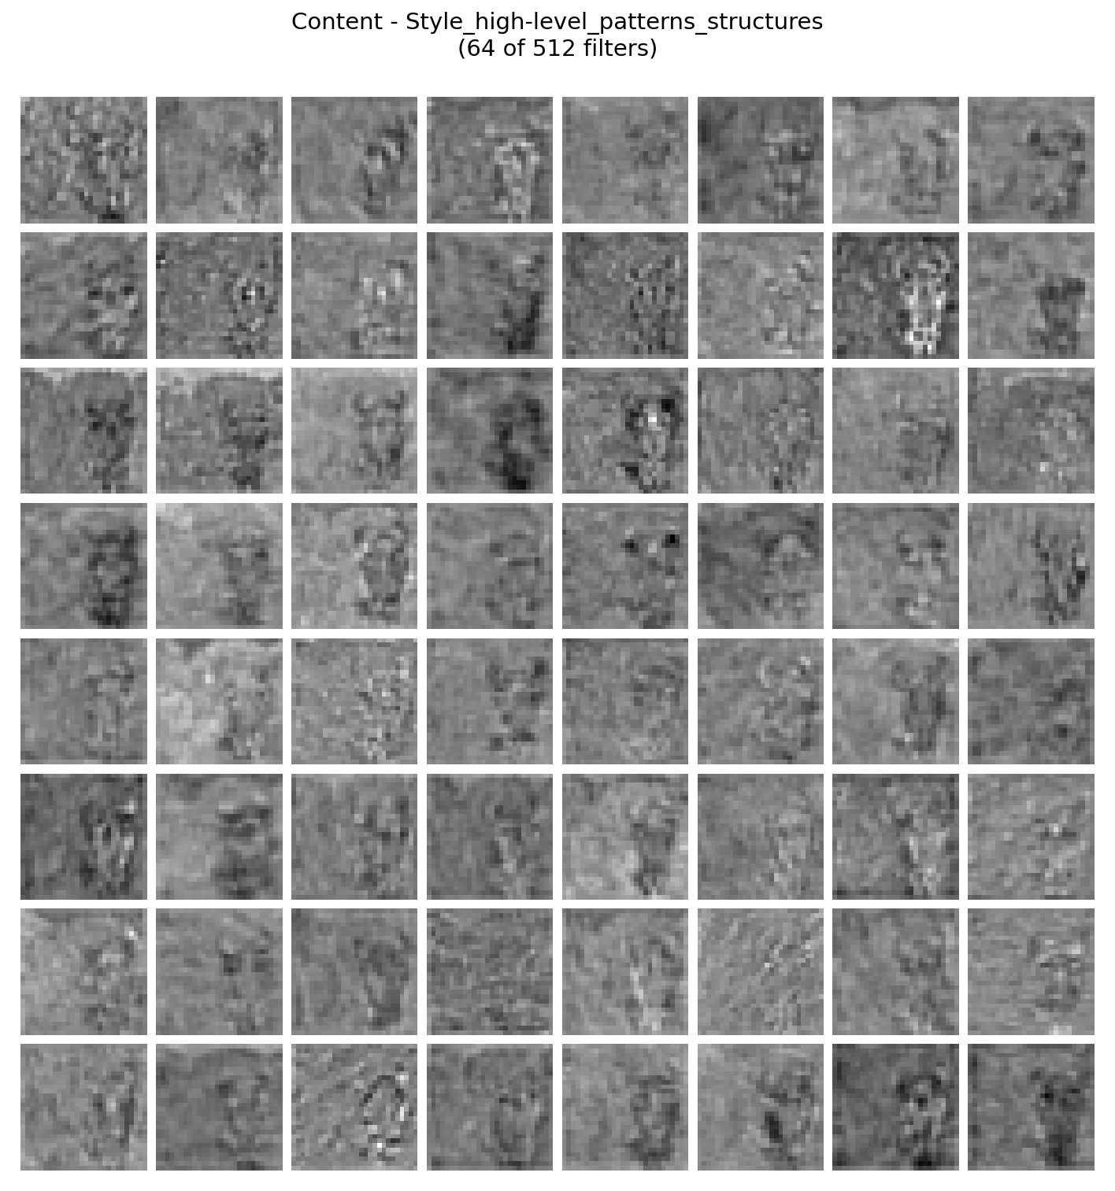
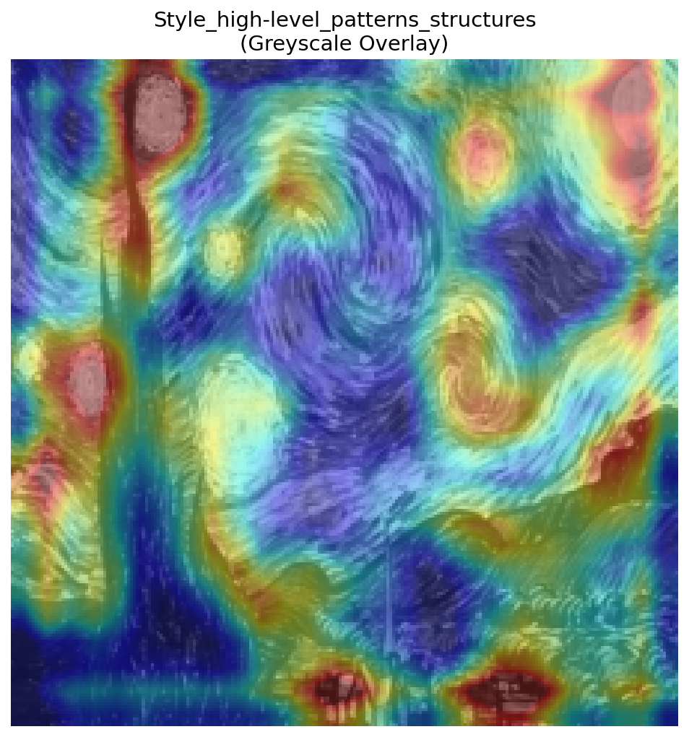
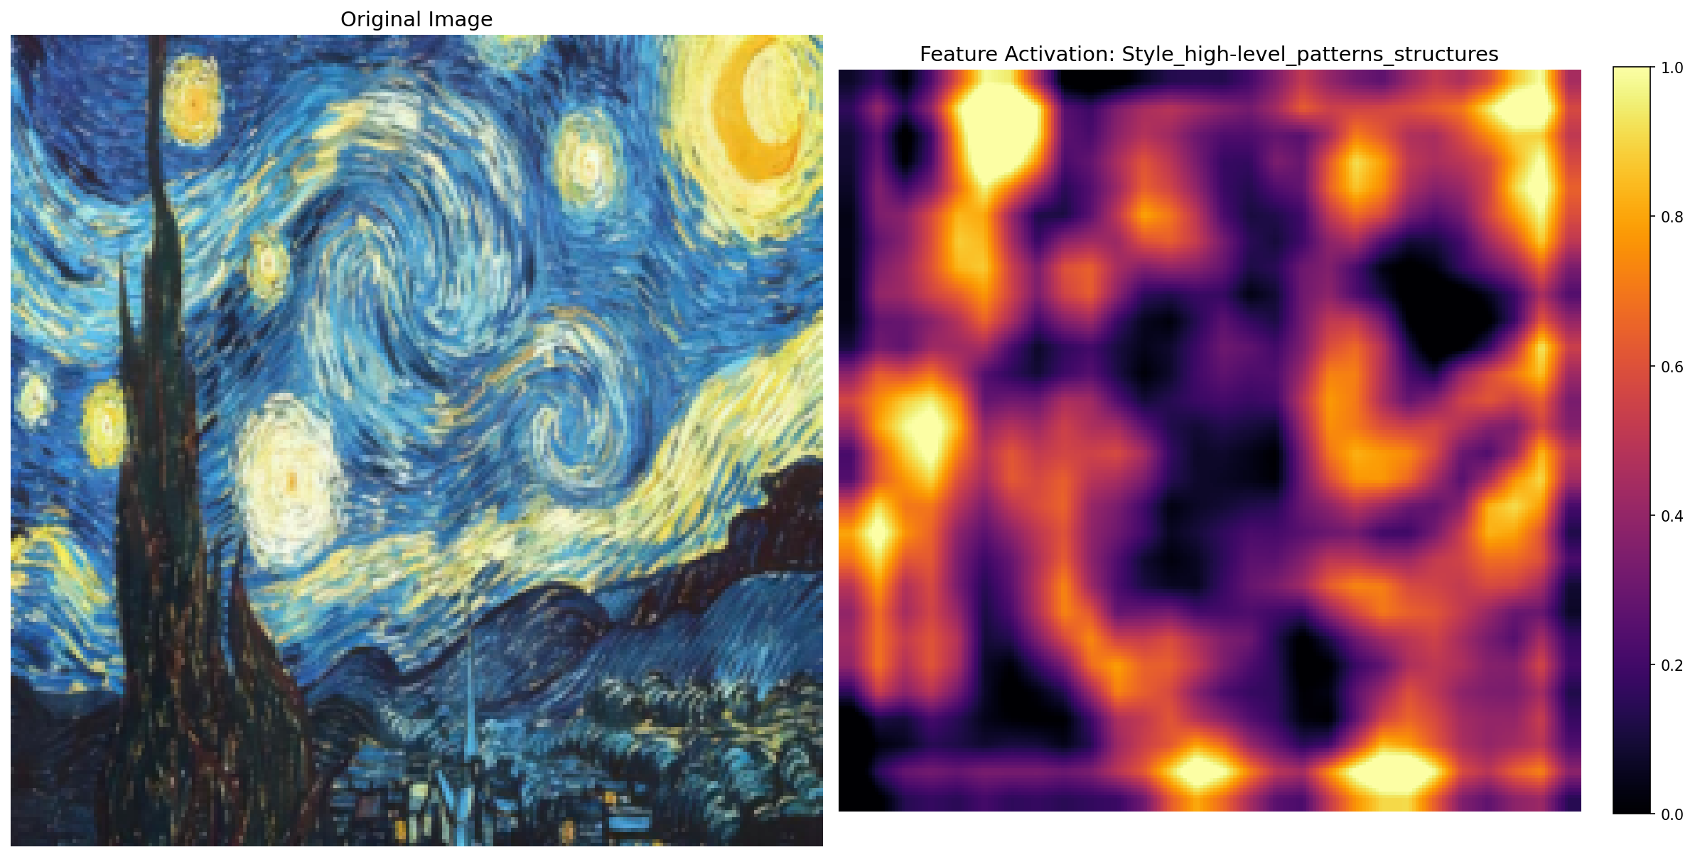
Convolutional layers
Conv 4
.
.
.

Slide 9
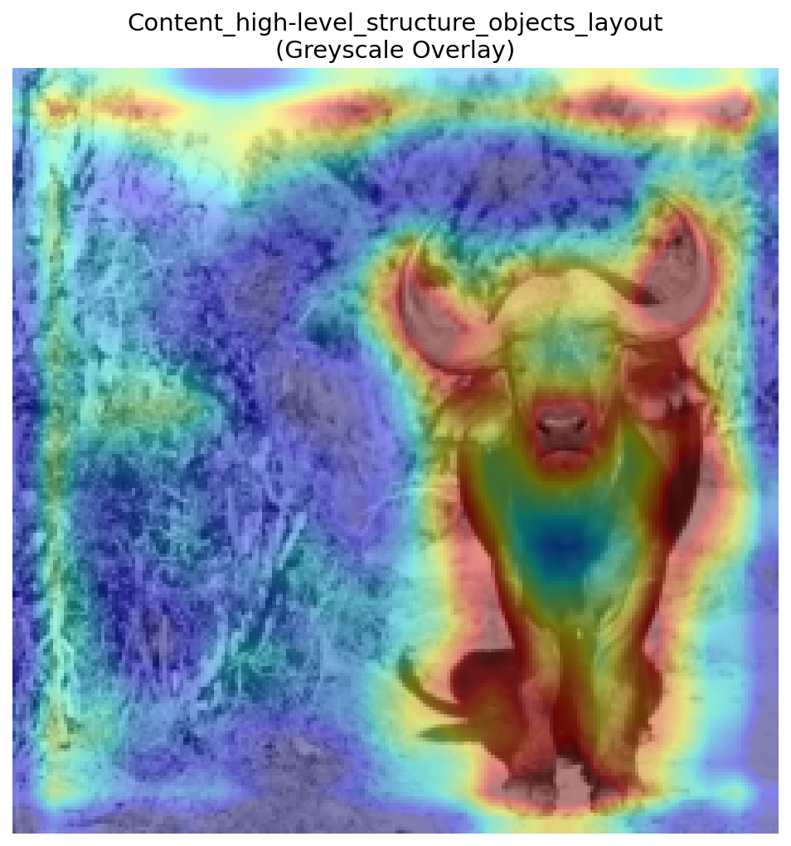
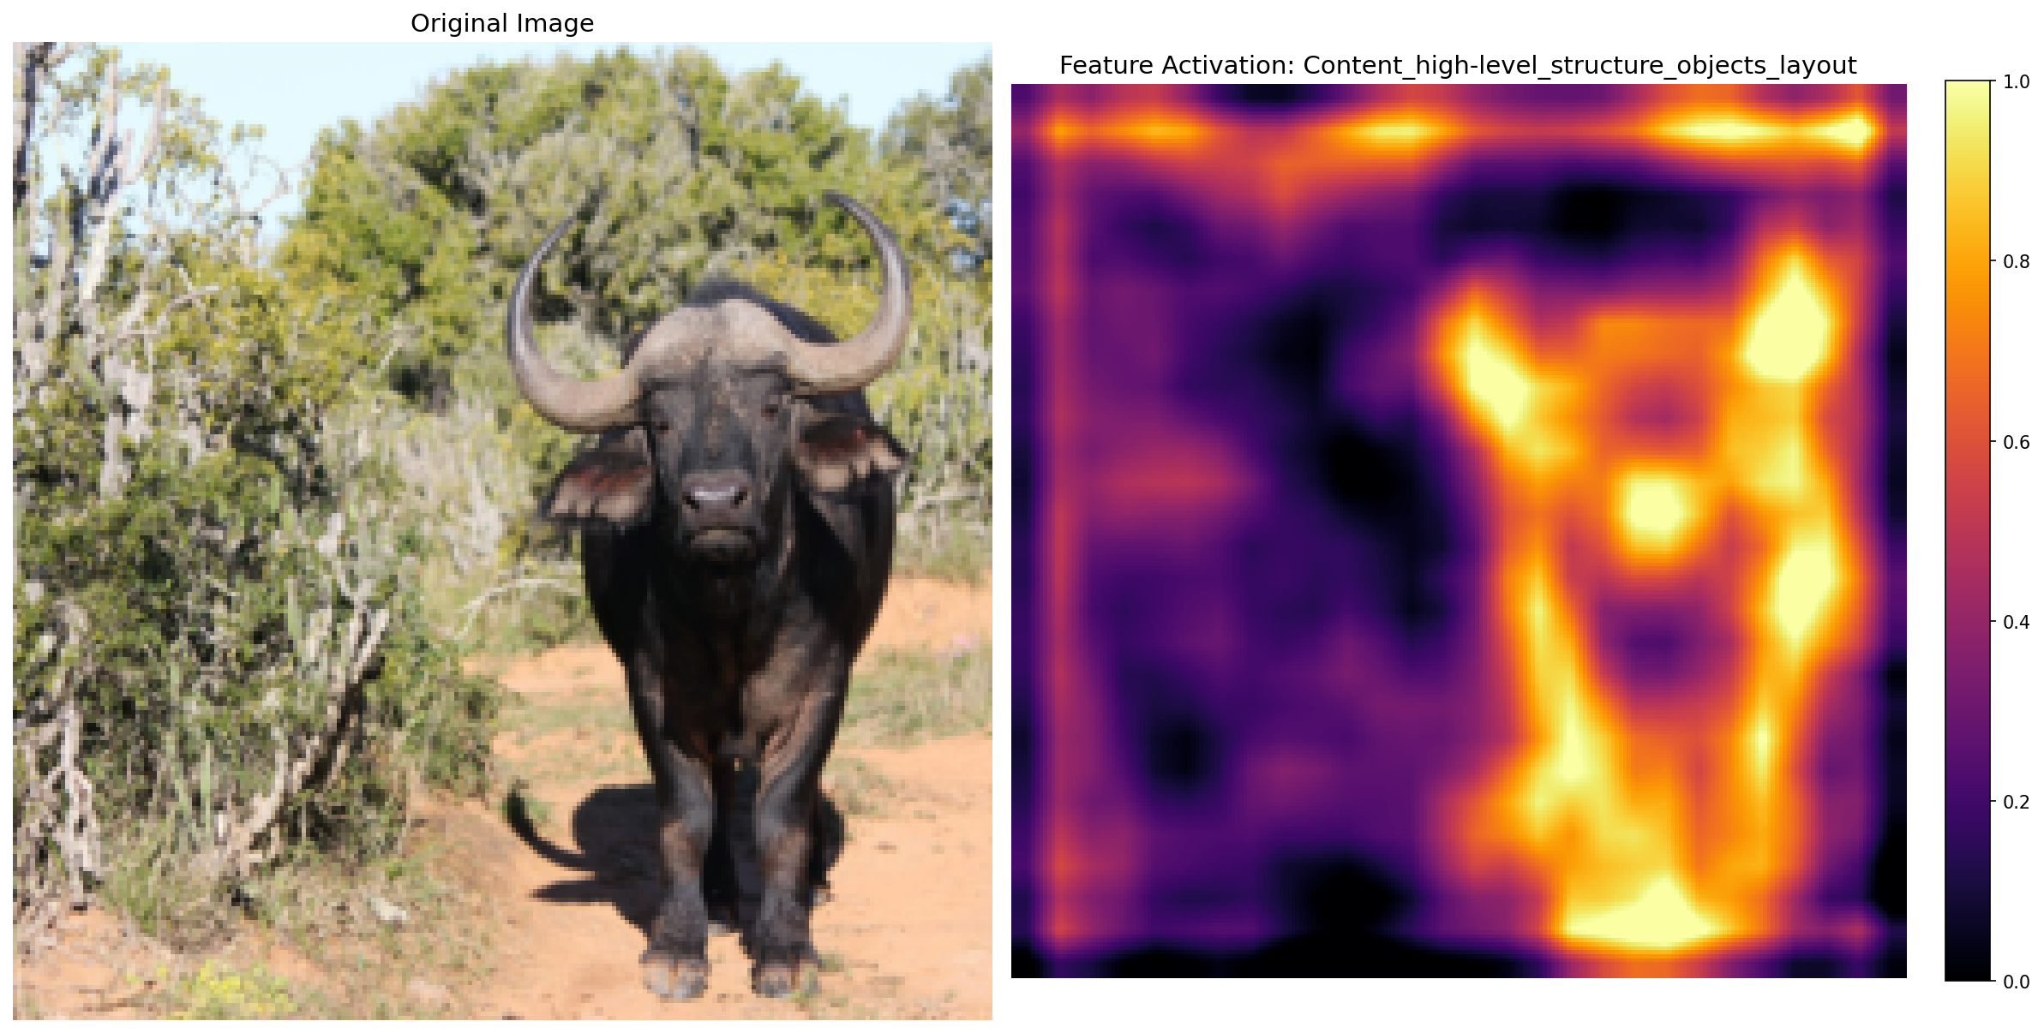
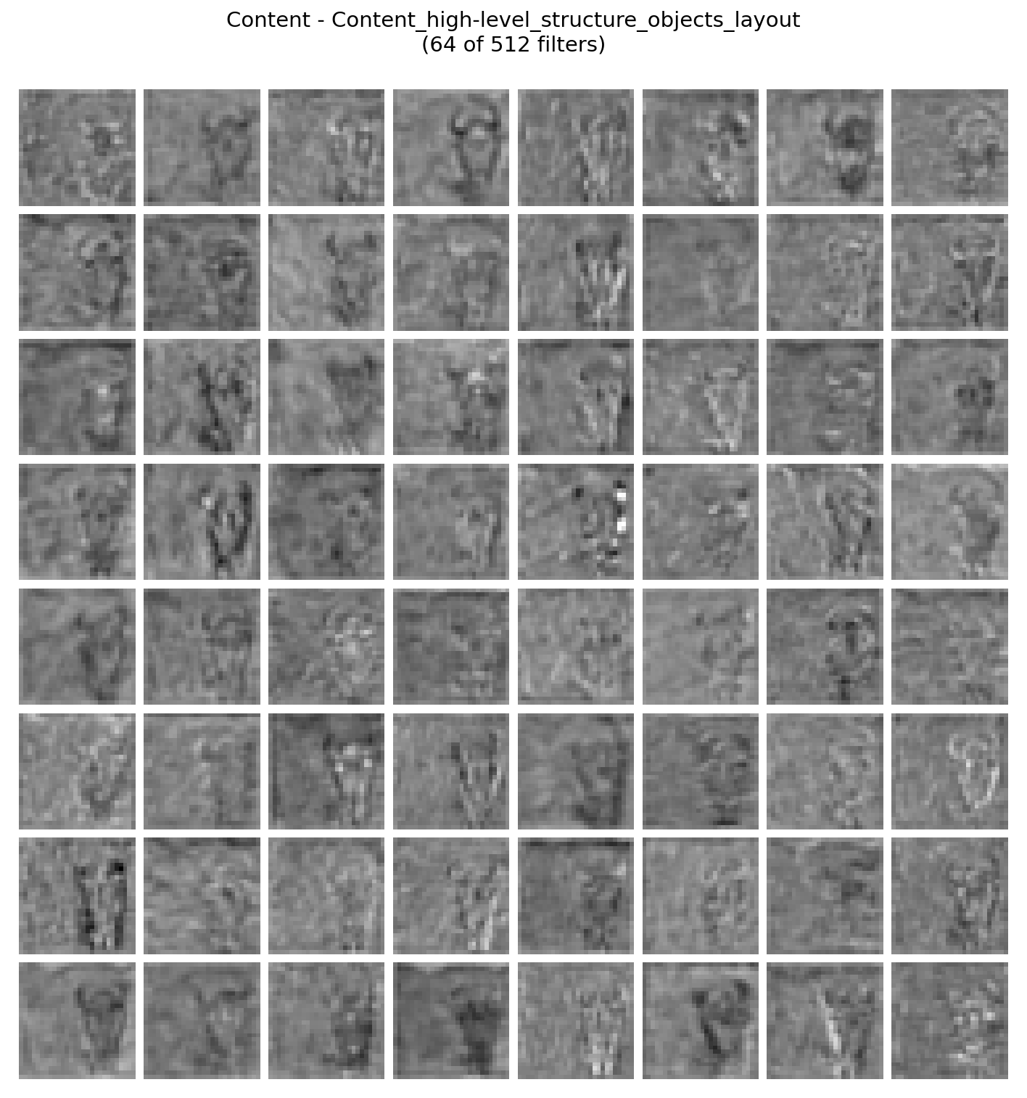
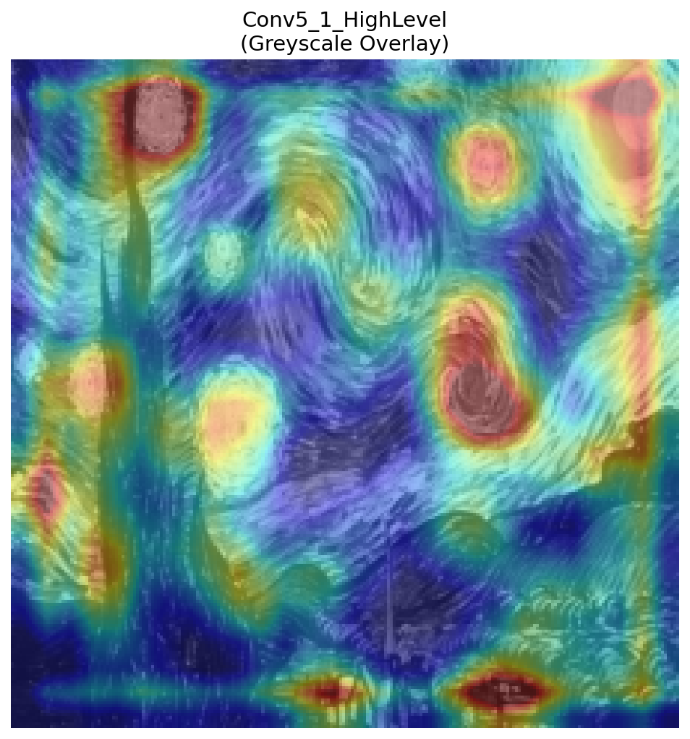
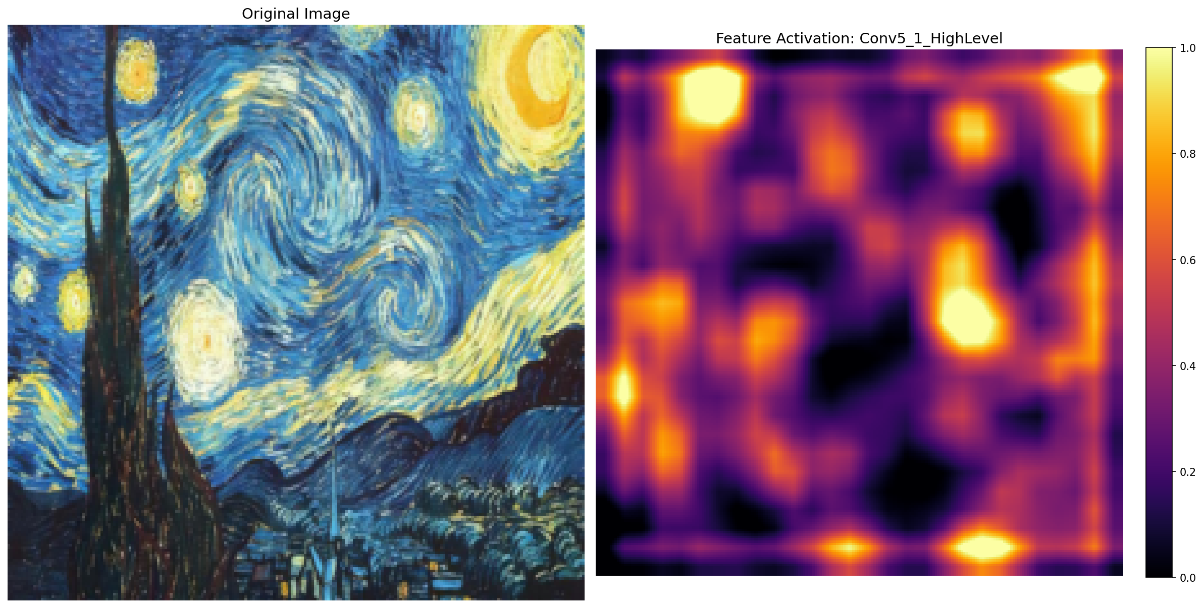
Convolutional layers
Conv 5
.
.
.

Slide 10
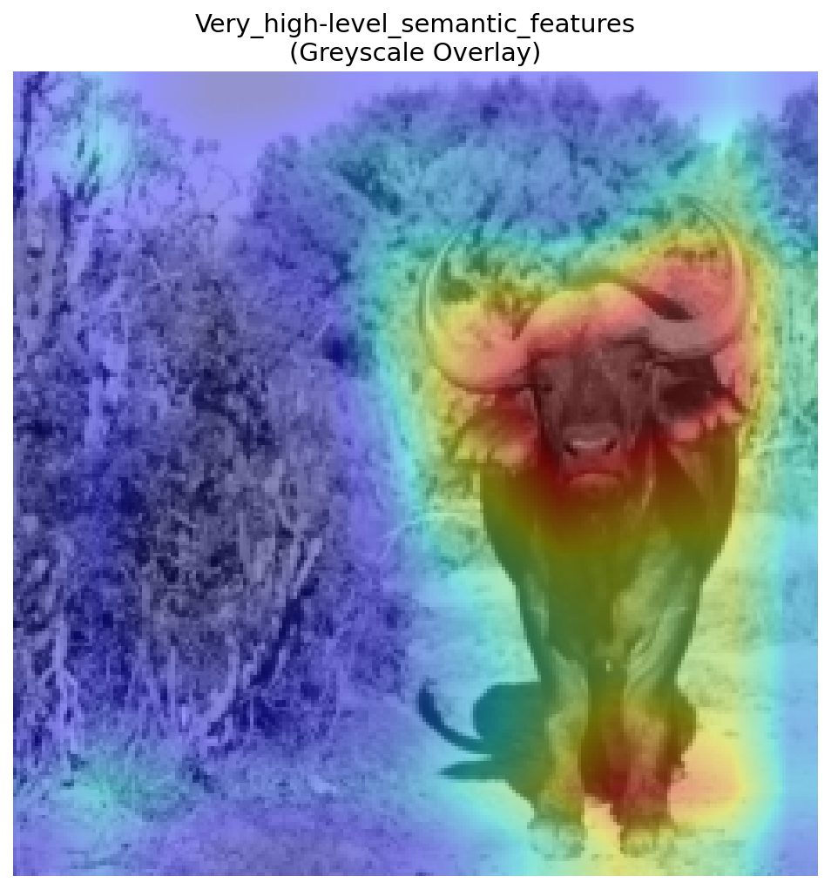
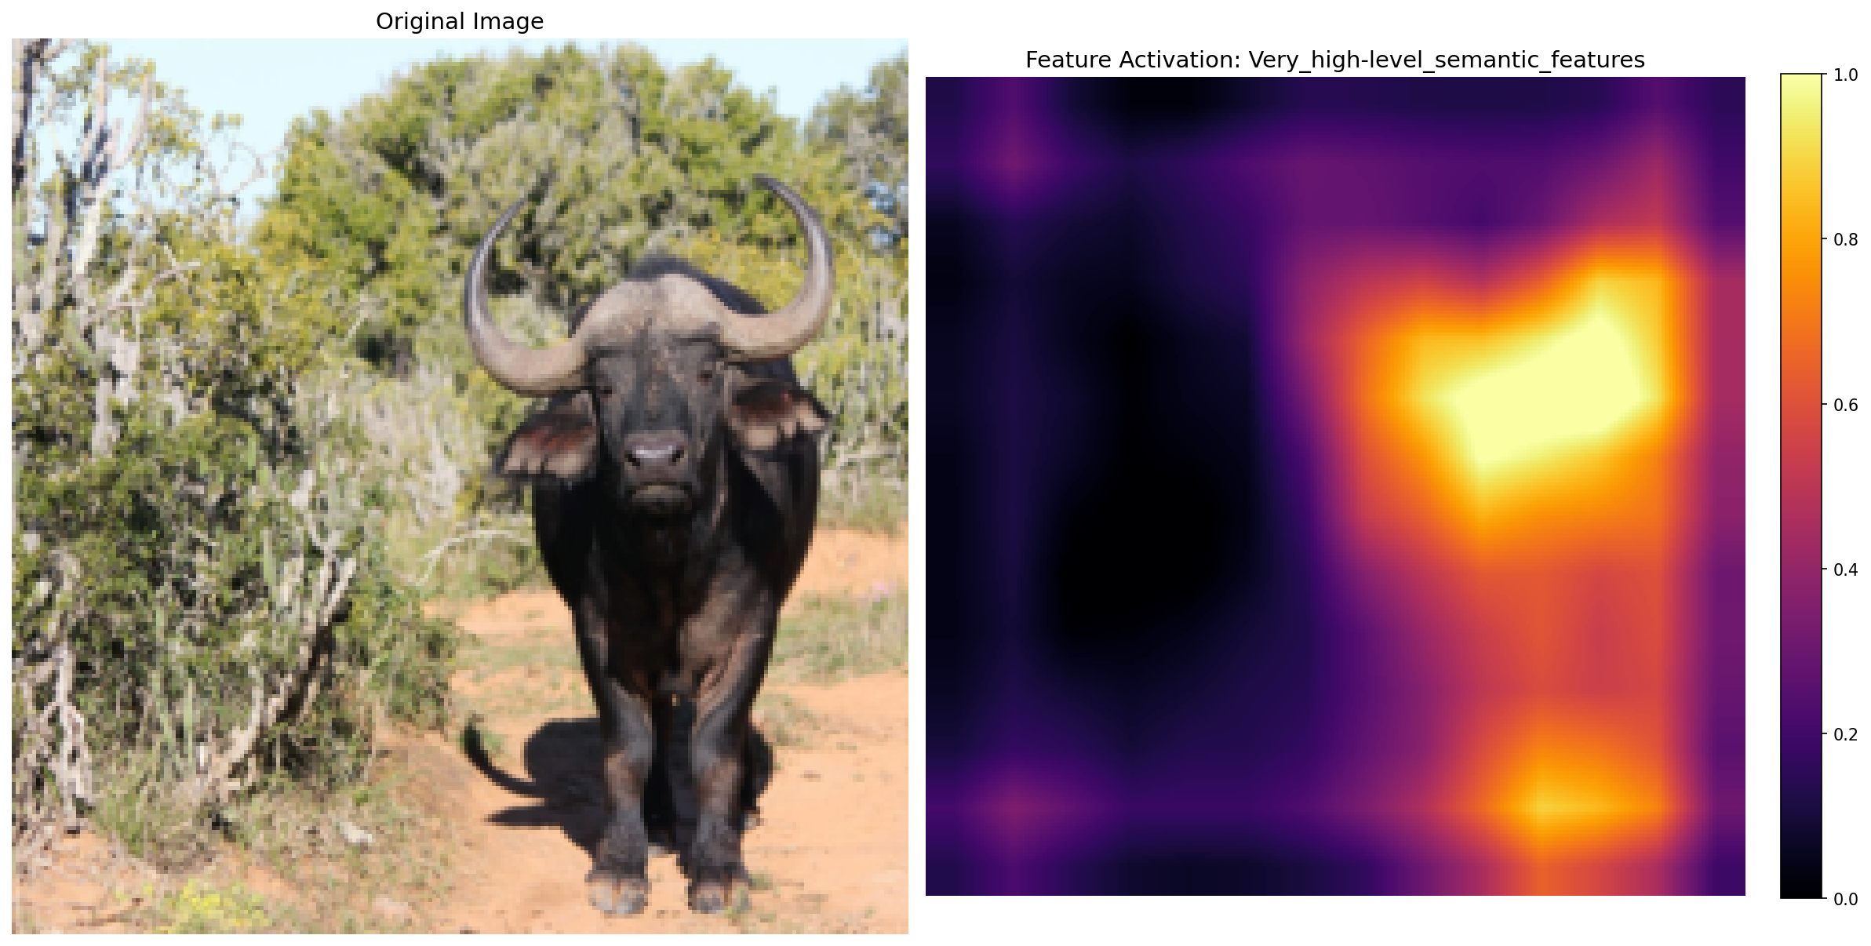
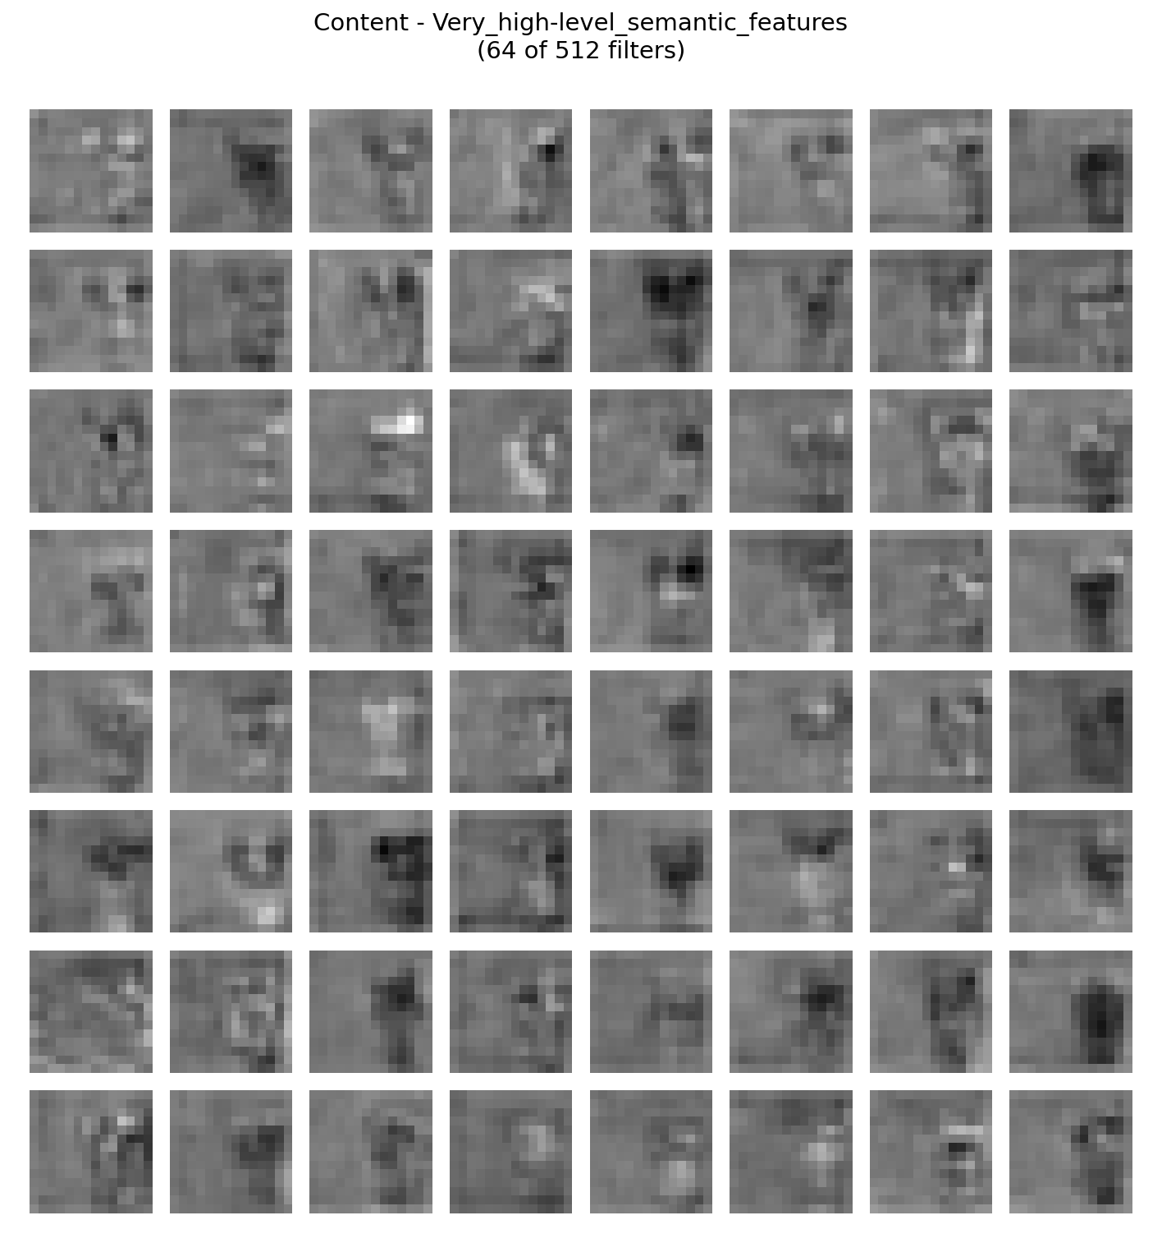
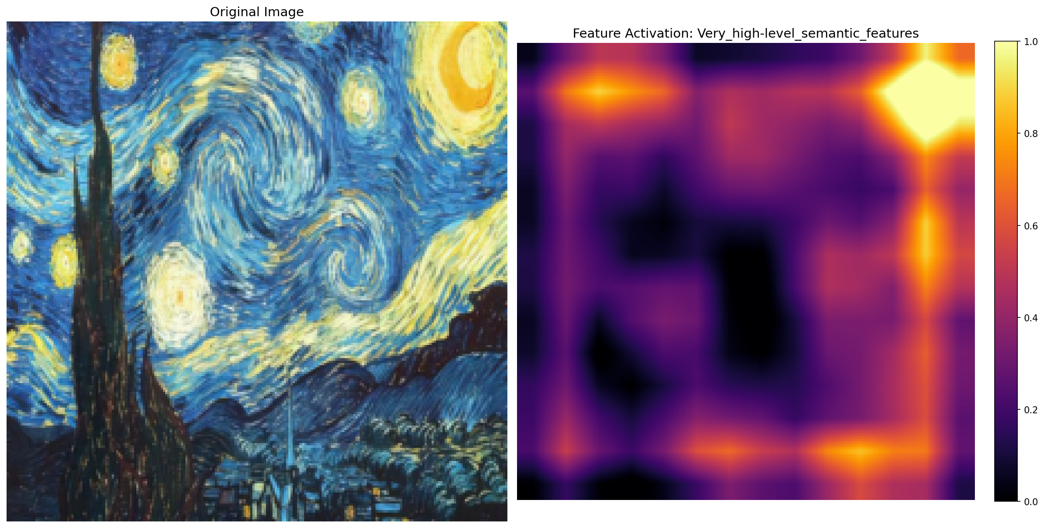
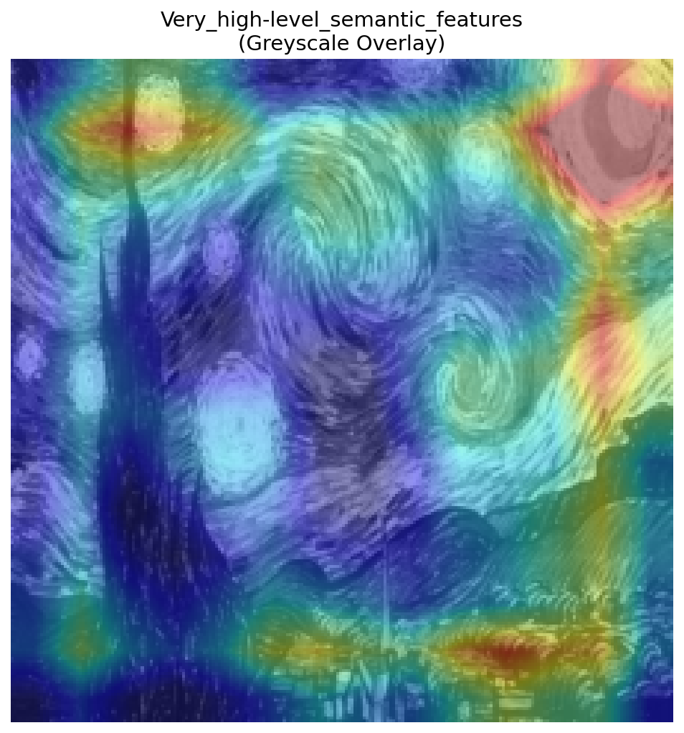
Convolutional layers
Conv 6
.
.
.

Slide 11
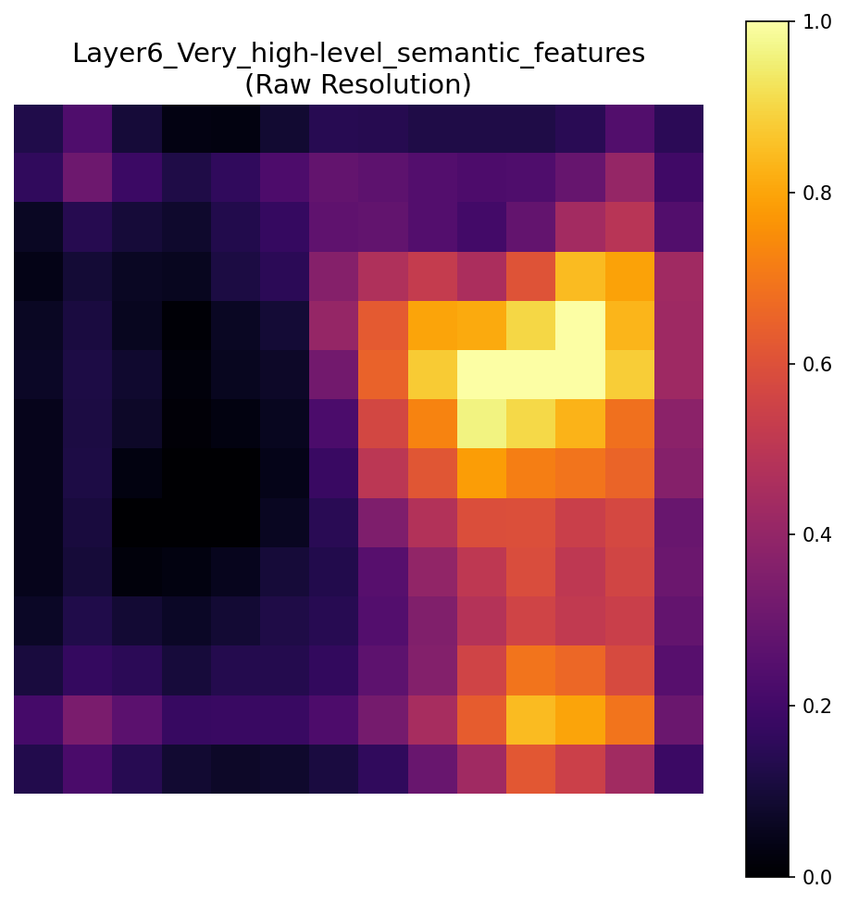
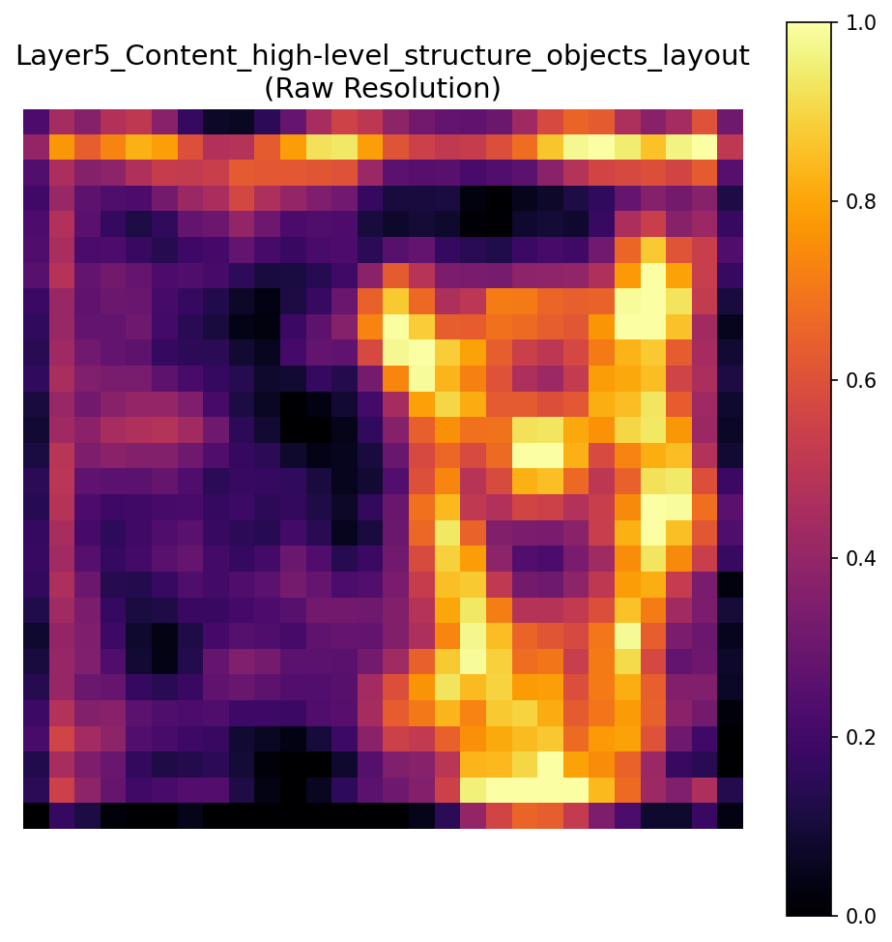
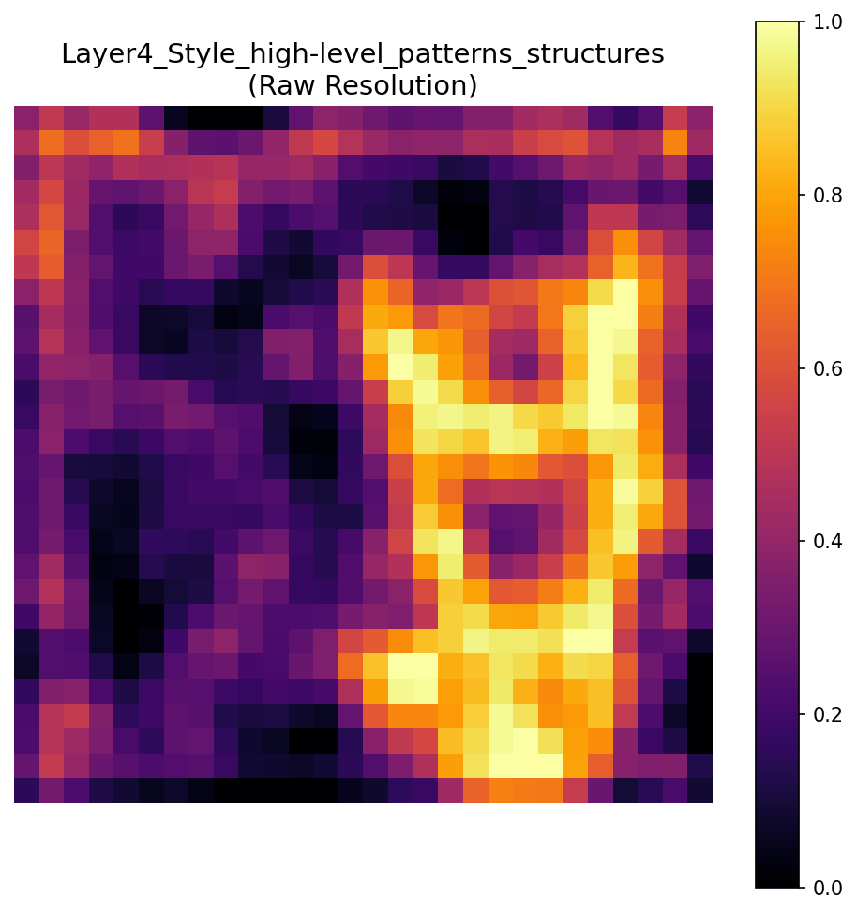
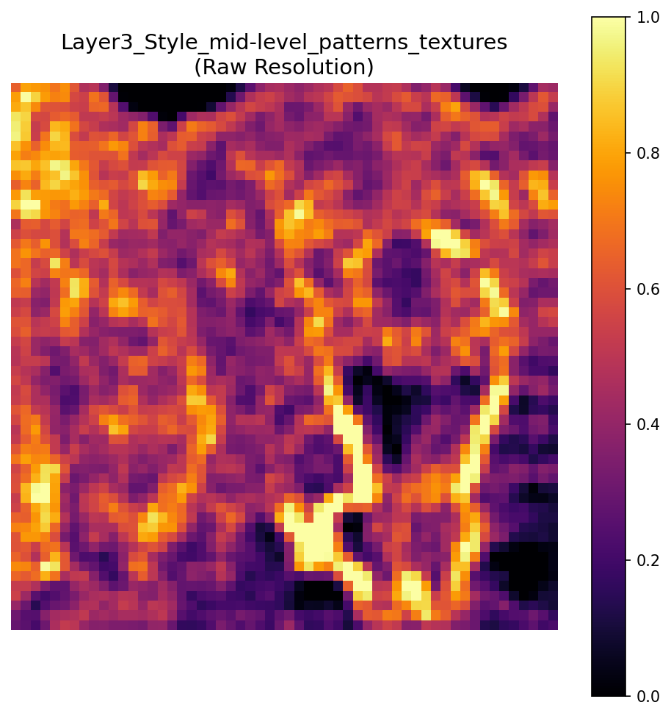
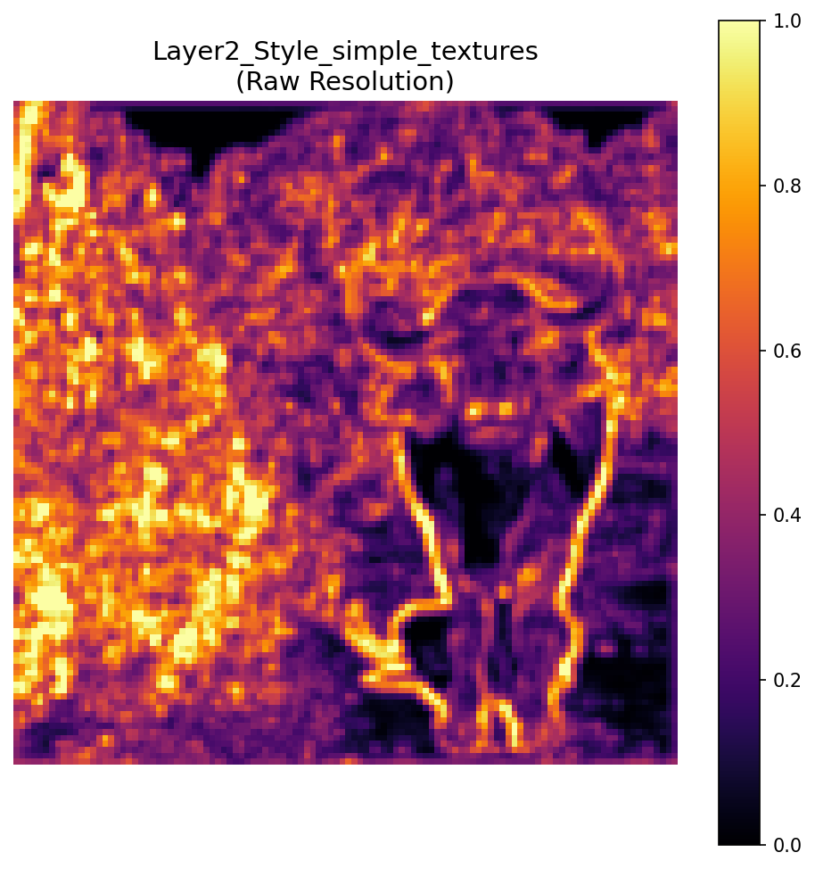
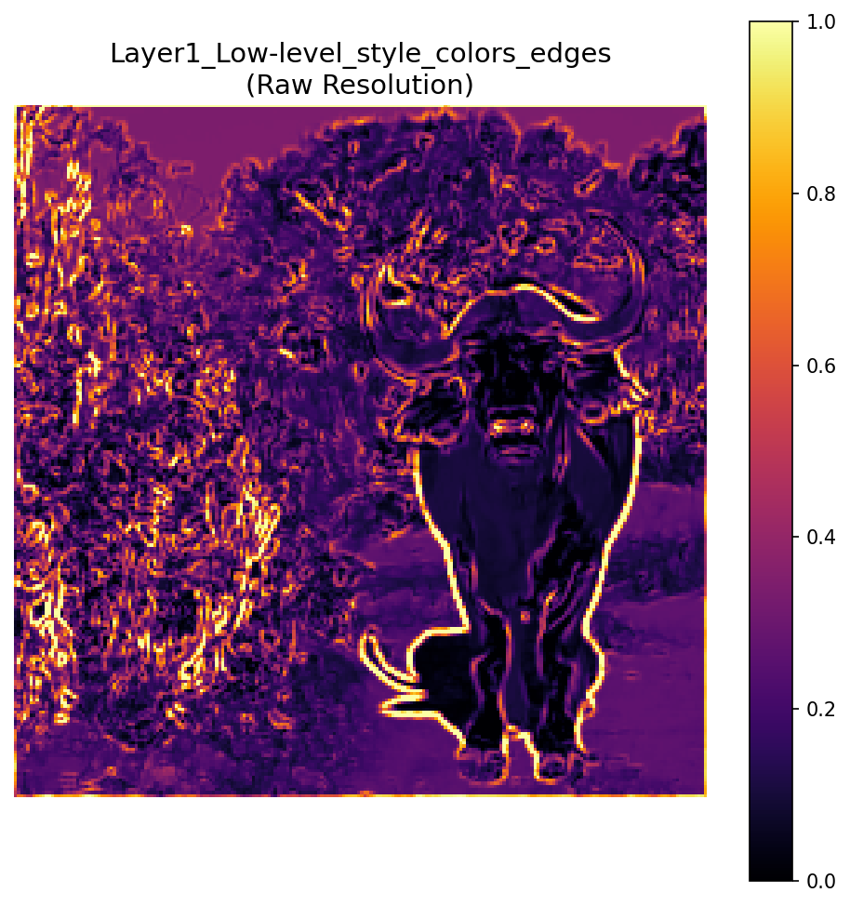
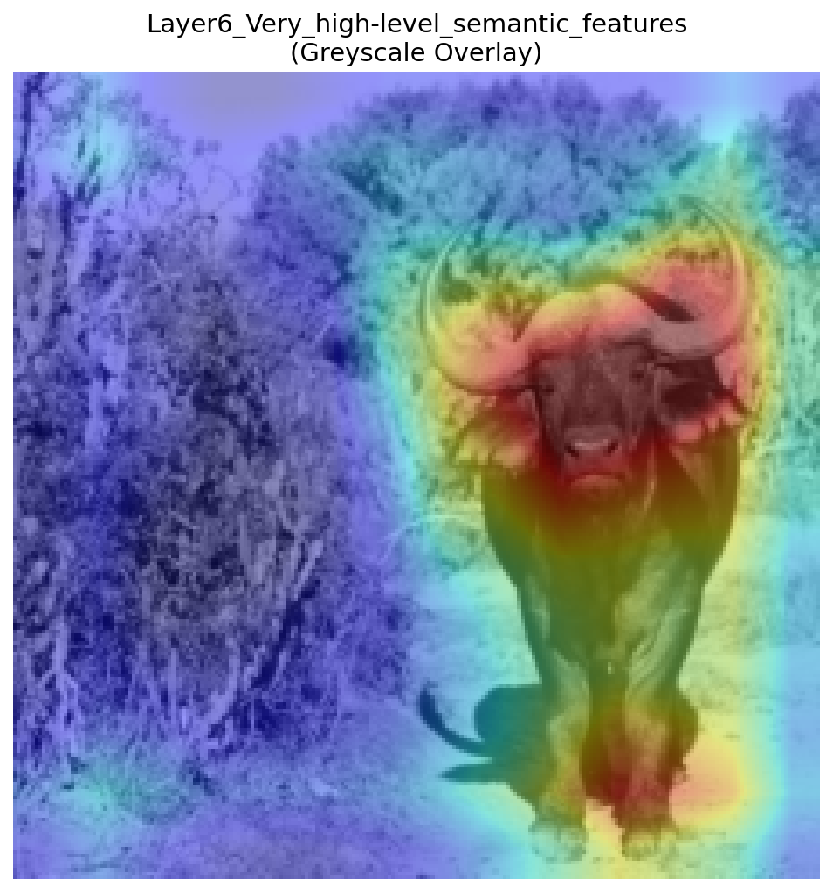
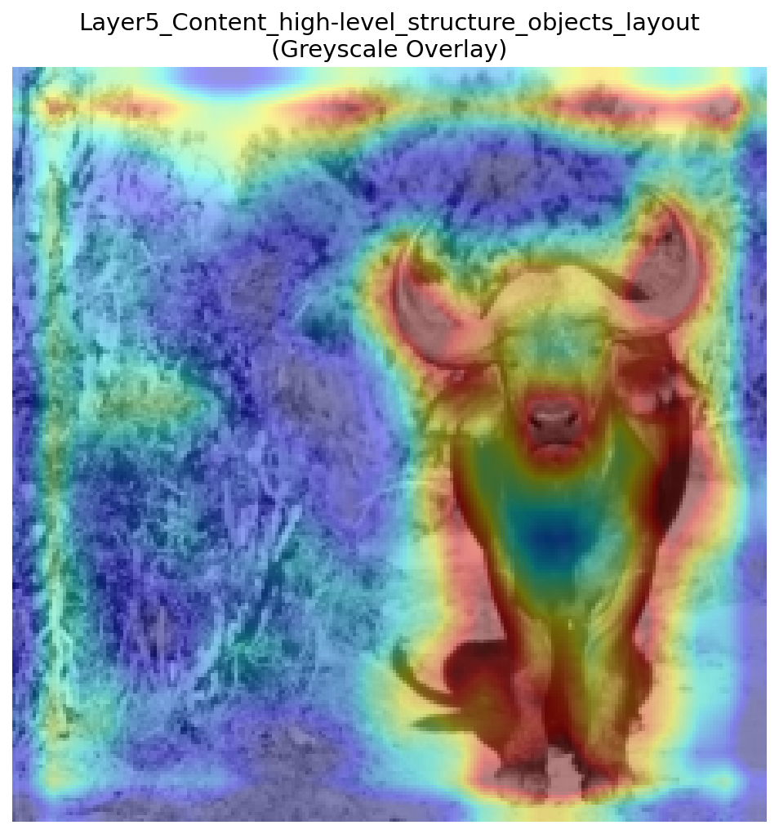




Convolutional layers
Original (un-interpolated) features vs bilinear interpolated features

Slide 12
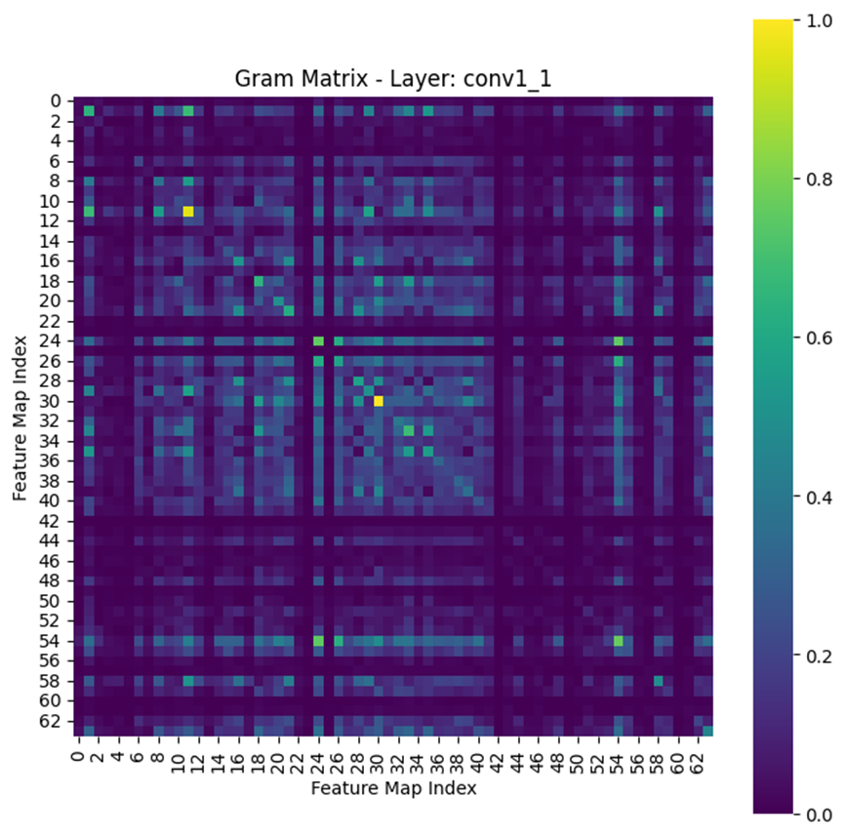
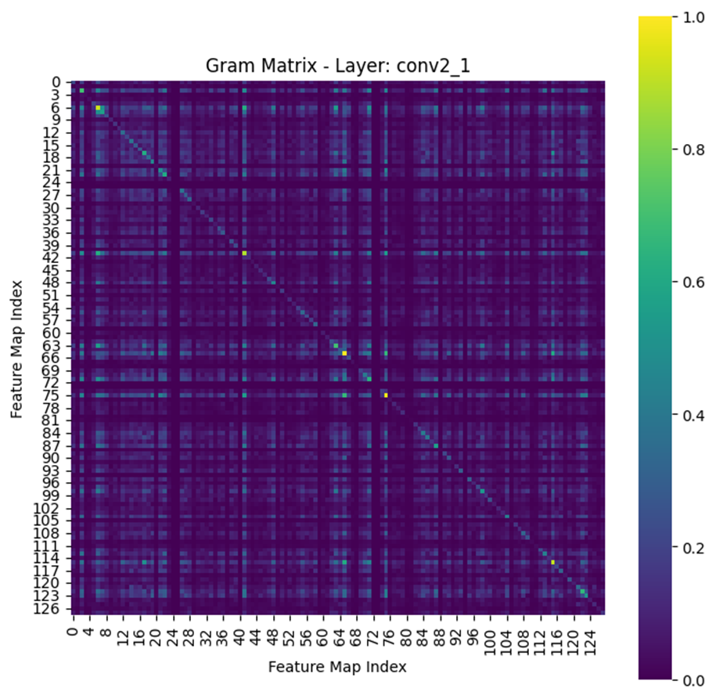
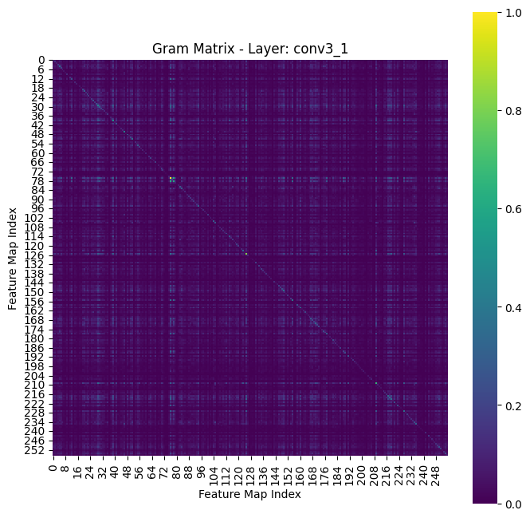
Gram matrix
This is where the magic happens!
Think of an image as being represented by features extracted by a neural network. These features tell us what is in the image, like textures, patterns, and shapes.
The Gram matrix takes these features and measures how they relate to each other (their correlation). It’s like asking, "How often do certain patterns appear together in the image?"
Technically, the Gram matrix is a square matrix that computes the similarity between pairs of features by multiplying them together.
Notes:
We know how to copy the buffalo (just match the deep layer features). But how do we copy 'Style'? We can't just copy the pixels, because the stars in 'Starry Night' won't be in the same place as our photo.
It asks: 'Whenever I see Blue, do I also see Swirls?'
If the answer is 'Yes' purely in the style image, we force our new image to do the same. If the painting has Blue+Swirls, our new image must have Blue+Swirls, even if they are in different spots.

Slide 13

Gram matrix
The style of an image is about patterns and textures, not specific objects. For example, in a painting, the brush strokes and color combinations define its style.
The Gram matrix captures these patterns by focusing on the relationships (correlations) between features rather than the features themselves.
Technically, the Gram matrix is a square matrix that computes the similarity between pairs of features by multiplying them together.
Reminder: cosine similarity $=\cos\left(θ\right)=\frac{u∙v}{\left\|u\right\|∙\left\|v\right\|}$
If two vectors are aligned (pointing in the same direction), the inner product is large and positive.
If two vectors are orthogonal (perpendicular), the inner product is zero.
If two vectors point in opposite directions, the inner product is negative.

Slide 14

Gram matrix
Let's say our feature map from some layer in tensor format is represented like that: $tensor=\left[\begin{matrix}\left(\begin{matrix}1 \\ 2\end{matrix}\right) & \left(\begin{matrix}1 \\ 1\end{matrix}\right) \\ \left(\begin{matrix}5 \\ 1\end{matrix}\right) & \left(\begin{matrix}0 \\ 9\end{matrix}\right)\end{matrix}\right]$
With $d=2$ $(number of channels in the layer),$and $h=2, w=2$ ($height and width of the tensor).$
Applying the function $tensor.view\left(d, h∗w\right)$ will flatten the tensor such that in the result matrix each row $i$ represents the flattened activation of the $i$ feature map.
$$tensor.view\left(d, h∗w\right)=\left(\begin{matrix}\begin{matrix}1 & 1 \\ 2 & 1\end{matrix} & \begin{matrix}5 & 0 \\ 1 & 9\end{matrix}\end{matrix}\right)$$
The last thing we need to do in order to obtain the gram matrix is inner dot:
$$torch.mm\left(tensor, tensor.t(\right))=\left(\begin{matrix}\begin{matrix}1 & 1 \\ 2 & 1\end{matrix} & \begin{matrix}5 & 0 \\ 1 & 9\end{matrix}\end{matrix}\right){\left(\begin{matrix}\begin{matrix}1 & 1 \\ 2 & 1\end{matrix} & \begin{matrix}5 & 0 \\ 1 & 9\end{matrix}\end{matrix}\right)}^{T}=gram_matrix$$
This process is calculated for each of the style layers in the style picture.

Slide 15

The whole process
$Define your content image and style image.$
$Choose a pre−trained convolutional model.$
$Choose the layers that will represent the style, and the layer that will represent the content.$
$Using the model and chosen layer − calculate for each picture its feature map for each chosen layer.$
$Calculate the gram matrix for each feature layer of the style image$
$Define target picture (best to just clone your content picture).$
$Define optimizer and number of epochs.$
$For i in epochs:$
$Calculate the current features of the target picture.$
$Compute the mean square loss between the target picture and content picture content layers.$
$For layer in style layers:$
$Compute the gram matrix of the target picture current layer.$
$Compute the square loss between the gram matrixes of the target and style for the current layer.$
$Recommended to predefine weights for each style layer – and to multiply the loss by it.$
$Normalize by the size off the layer and add to the whole style loss.$
$Combine the content loss with the style loss multiplying by corelated weights.$
$Update the target picture.$

Slide 16


The whole process
$$Choose a pre−trained convolutional model.$$
$$Choose the layers that will represent the style, and the layer that will represent the content.$$
In order for us to understand which layers we should take, we can print the model architecture:
In vgg19 case, we will take layers 0, 5, 10, 19 as style layers.
And 21 as content layer.
def style_transfer(model, style_img_path, content_img_path, content_weight=1, style_weight=1e3, num_steps=5001, model_name='vgg19_pretrained’):
model = model.features #Gives us access to the layers of features
layers = {
'0': 'conv1_1', '5': 'conv2_1', '10': 'conv3_1', '19': 'conv4_1',
'21': 'conv4_2'
}
style_weights = {
'conv1_1': 0.5, 'conv2_1': 0.5, 'conv3_1': 0.5, 'conv4_1': 0.3
}
content_layer = 'conv4_2'

Slide 17

The whole process
$$Using the model and chosen layer − calculate for each picture its feature map for each chosen layer.$$
$$Define target picture (best to just clone your content picture).$$
# Prepare model for evaluation, disabling gradient computation
model.to(device).eval()
for param in model.parameters():
param.requires_grad_(False)
# Load and preprocess the content and style images
content = load_image(content_img_path).to(device)
style = load_image(style_img_path).to(device)
# Extract features from content and style images
content_features = get_features(content, model, layers)
style_features = get_features(style, model, layers)
target = content.clone().requires_grad_(True).to(device)
def get_features(image, model, layers):
features = {}
x = image
for name, layer in model._modules.items():
x = layer(x)
if name in layers:
features[layers[name]] = x return features
def load_image(img_path, shape=(224, 224)):
image = Image.open(img_path).convert('RGB')
# Define transformation to resize, normalize, and convert to tensor
in_transform = transforms.Compose([
transforms.Resize(shape),
transforms.ToTensor(),
transforms.Normalize((0.485, 0.456, 0.406), (0.229, 0.224, 0.225))
])
# Apply transformations, remove alpha channel, and add batch dimension
image = in_transform(image)[:3, :, :].unsqueeze(0)
return image.to(device)
First, we are transferring our model to evaluation mode – we don’t want to change its parameters.
We are loading our image in the correct format for the model.
We are calculating the model outputs and saving them for each layer of interest defined in the previous phase.
We define our target pic, which is our studied parameters in this task.

Slide 18

The whole process
$$Calculate the gram matrix for each feature layer of the style image$$
$$Define optimizer and number of epochs.$$
$$For i in epochs:$$
$$Calculate the current features of the target picture.$$
$$Compute the mean square loss between the target picture and content picture content layers.$$
style_grams = {layer: gram_matrix(style_features[layer]) for layer in style_features}
optimizer = optim.Adam([target], lr=0.003)
# Style transfer loop
for ii in range(1, num_steps + 1):
# Extract features from target image
target_features = get_features(target, model, layers)
# Compute content loss
content_loss = torch.mean((target_features[content_layer] - content_features[content_layer])**2)
def gram_matrix(tensor):
_, d, h, w = tensor.size()
tensor = tensor.view(d, h * w)
gram = torch.mm(tensor, tensor.t())
return gram

Slide 19

The whole process
$$For layer in style layers:$$
$$Compute the gram matrix of the target picture current layer.$$
$$Compute the square loss between the gram matrixes of the target and style for the current layer.$$
$$Recommended to predefine weights for each style layer – and to multiply the loss by it.$$
$$Normalize by the size off the layer and add to the whole style loss.$$
$$Combine the content loss with the style loss multiplying by corelated weights.$$
$$Update the target picture.$$
# Compute style loss by comparing Gram matrices for each layer
style_loss = 0
for layer in style_weights:
target_feature = target_features[layer]
target_gram = gram_matrix(target_feature)
_, d, h, w = target_feature.shape
style_gram = style_grams[layer]
layer_style_loss = style_weights[layer] * torch.mean((target_gram - style_gram)**2)
style_loss += layer_style_loss / (d * h * w)
# Calculate total loss and update target image
total_loss = content_weight * content_loss + style_weight * style_loss
optimizer.zero_grad()
total_loss.backward()
optimizer.step()

